Slide 1


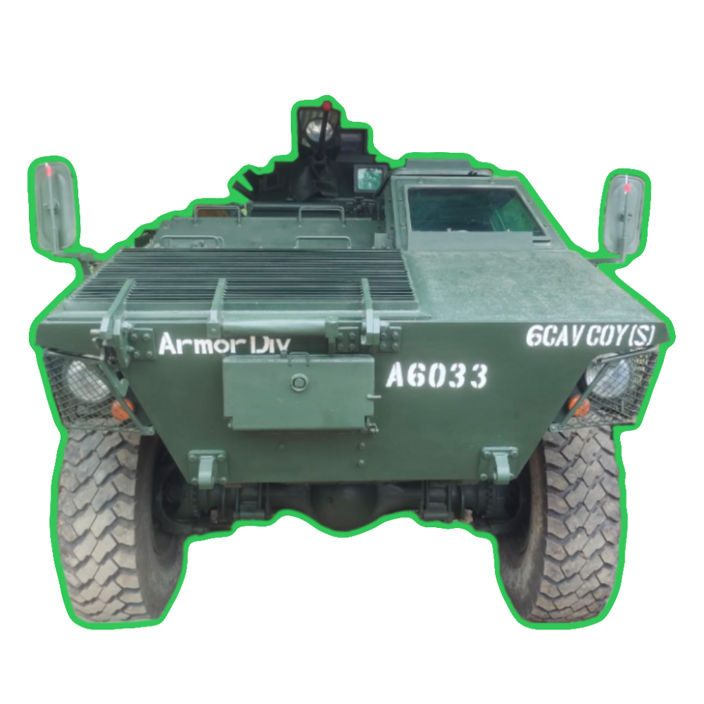
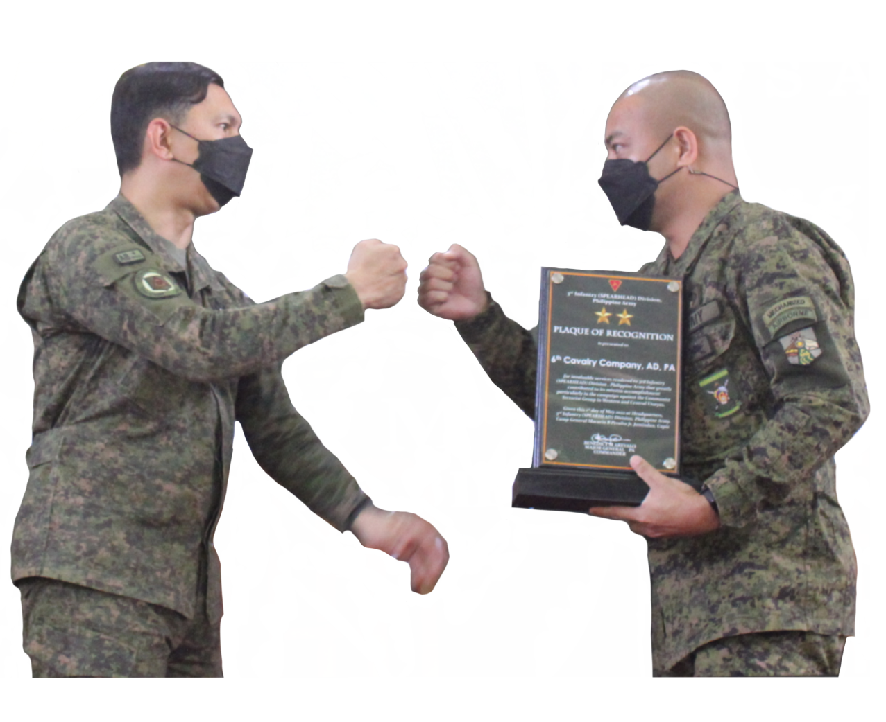
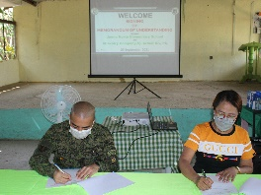
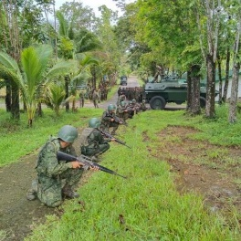
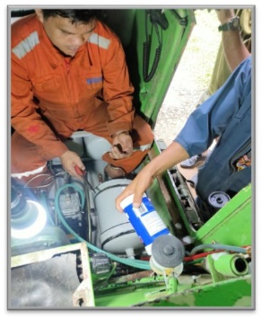
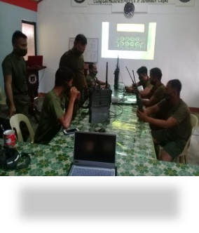
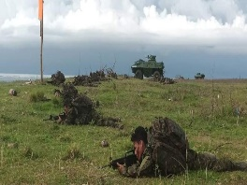
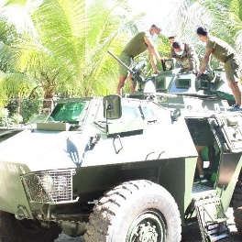
Notes:
Appropriate greetings. (Click)

Slide 2
ACTIONS-TAKEN TO FINDINGS FROM PREVIOUS ASSESSMENT
COMPLIANCES AND ACCOMPLISHMENTS TO DC’s GUIDANCE
UNIT SIGNIFICANT ACCOMPLISHMENTS
ISSUES AND CONCERNS
Notes:
(Click) Sir in the next 15 minutes or so please allow me to quickly discuss the following topics. (Click)

Slide 3
ACTIONS-TAKEN TO FINDINGS FROM PREVIOUS ASSESSMENT
ASPECT | ACTIONS-TAKEN
DECREASE IN PERSONNEL READINESS AND DID NOT REACH THE PBDG TARGET FOR CY 2022
6Cav continuously enhances its Qualification Rating through regular conduct of JRRS Reviews to ensure maximum points for every personnel.
Likewise, priority personnel due for career course schooling were re-programmed.
LOW FILL-UP FOR IFAKS AND CLS KITS
Replenishment of IFAKs and CLS Kits of this unit was included in the APB 2023 programming.
NON-ACCOMMODATION OF PROGRAMMED PERSONNEL FOR CAREER COURSES (BOTH ARMOR & NON ARMOR AFPOS/MOS)
Priority personnel for career courses from last year were re-programmed to be accommodated this year and in the succeeding years.

Slide 4
ACTIONS-TAKEN TO FINDINGS FROM PREVIOUS ASSESSMENT
ASPECT | ACTIONS-TAKEN
 | 6Cav increased its tactical and non-tactical activities in order to support in increasing 3ID’s hit factor.
 | The unit endeavored to procure commercially available equipment to sustain and increase equipment readiness of the unit.
 | 6Cav ensured and maintained that processing and clearing of PAPs are conducted on time.
TACTICAL ACTIVITIES DID NOT TRANSLATE TO AN INCREASE IN HIT FACTOR
INSUFFICIENTLY EQUIPPED UNITS
Since last assessment, C4S equipment and maintenance readiness has increased from 82% to 88% due to the unit’s intensive maintenance of C4S equipment and support from OG6, Armor Div, PA.
DECREASING C4S EQUIPMENT MAINTENANCE READINESS OF SOME UNITS
LATE PROCESSING OF PROGRAM, ACTIVITIES, AND PROJECTS (PAPS)
Notes:
For equipment readiness: Water Dolly, IFAK and CLS kit replenishments, PAS, Laptop and Desktop Computers, Printers.

Slide 5
COMPLIANCES AND ACCOMPLISHMENTS TO DC’s GUIDANCE
PERSONNEL READINESS
PERSONNEL READINESS
PARAMETERS |  | RATE (%) | REDCON
PSG Rating | Qualification Rating = Rank Rating (40%) + PS Rating (60%) | PSG (50%) + QR (50%)
84% | 80% = 27% + 53% | 84% + 79% = 82% | R2
PSG Rating | Qualification Rating | Personnel Readiness Rating | ASSESSMENT
82% | 81% | 82 | The over-all personnel readiness of the unit increased from 81% to 82% with the promotion and reassignment of personnel to this unit.
PERSONNEL FILL-UP ( AS OF 31 Nov 2022)
PERSONNEL | TOE (S-2019) | Actual Assigned | Percentage Fill-up
Officer | 4 | 2 | 50%
EP | 90 | 77 | 86%
Total | 94 | 79 | 82%
Notes:
Moving on to the compliances and accomplishments to our Division Commander’s guidance on Personnel. (Click)
Comparatively, personnel readiness decreased by 1% from 2nd Qtr 2021 as compared to the present personnel readiness rating (82% to 81%) but this was compensated by increasing the Qualification Rating and programming personnel for schooling/specialization to gain Career Points, AFPOS/MOS Points and Specialization Points. (Click)
The 4% decrease in PSG Rating was due to the transfer of seven (7) personnel to other units (3 to TankBn, 2 to 6MechBn, 1 to 2CavCoy and 1 to ACDO). (Click)
The slight increase in Rank Rating and PS Rating, 24% to 25% and 56% to 57% respectively, was the result of the internal rationalization of the unit and reshuffling of designations within the company discussed during monthly JRRS Reviews. (Click)

Slide 6
COMPLIANCES AND ACCOMPLISHMENTS TO DC’s GUIDANCE
PERONNEL FILL-UP
RESULTANT FILL-UP OF PRIVATES
Unit | OFFCR | EP | Present EP Fill-up as of 10 November 2022 |  | Nr of Gained Privates |  | Resultant after Distribution of Pvt
 |  |  | Nr | (% Fill-up) |  |  | EP | (% Fill-up)
H6CAV COY (S) | 2 | 32 | 69 | 76.66% | 8 |  | 77 | 85.55%
1TH SCT PLTN |  | 20
2ND SCT PLTN |  | 13
MORTAR SECTION |  | 4
TOTAL | 2 | 69

Slide 7
COMPLIANCES AND ACCOMPLISHMENTS TO DC’s GUIDANCE
CAREER COURSES
 | 2022 |  |  |  |  |  |  | 2022
UNIT | 1TC |  | 2TC |  | 3TC |  | TOTAL | 1TC |  | 2TC |  | 3TC |  | TOTAL
 | OFFR | EP | OFFR | EP | OFFR | EP |  | OFFR | EP | OFFR | EP | OFFR | EP
 | PROGRAMMED |  |  |  |  |  |  | ACTUAL
H6CAV COY (S) |  | 4 |  | 4 |  | 2 | 10 |  | 1 |  |  |  |  | 1
TOTAL
List of Personnel who were programmed for Career Courses CY 2022
Unit | Name | Trng Cycle | Course to be Taken
6Cav Coy (S) | SSg Benjie M Cezar 845366 (Arm) PA | 1TC | ANCOAC
 | Sgt Ramar H Curativo 851353 (Arm) PA |  | ANCOAC
 | PFC Cherish Mae M Domingo 933425 (Arm) PA |  | FSNCOBC
 | PFC Venzon B Buslig 935427 (Arm) PA |  | ANCOBC
 | Sgt Jomar C Chiefe 881577 (AGS) PA | 2TC | ANCOAC
 | Sgt Alvin A Flores 887745 (Arm) PA |  | ANCOAC
 | PFC Russel B Zabala 935403 (QMS) PA |  | QMSNCOBC
 | PFC Rode John C Panique 935505 (AGS) PA |  | AGSNCOBC
Notes:
Moving on to the compliances and accomplishments to our Division Commander’s guidance on Personnel. (Click)
Comparatively, personnel readiness decreased by 1% from 2nd Qtr 2021 as compared to the present personnel readiness rating (82% to 81%) but this was compensated by increasing the Qualification Rating and programming personnel for schooling/specialization to gain Career Points, AFPOS/MOS Points and Specialization Points. (Click)
The 4% decrease in PSG Rating was due to the transfer of seven (7) personnel to other units (3 to TankBn, 2 to 6MechBn, 1 to 2CavCoy and 1 to ACDO). (Click)
The slight increase in Rank Rating and PS Rating, 24% to 25% and 56% to 57% respectively, was the result of the internal rationalization of the unit and reshuffling of designations within the company discussed during monthly JRRS Reviews. (Click)

Slide 8
COMPLIANCES AND ACCOMPLISHMENTS TO DC’s GUIDANCE
CAREER COURSES
List of Personnel who were programmed for Career Courses CY 2022
Unit | Name | Trng Cycle | Course to be Taken
H6CAV COY (S) | Sgt Fredierick R Garma 887751 (MI) PA | 3TC | MINCOAC
 | Sgt Edgar C Elayda Jr 887759 (Arm) PA |  | ANCOAC
Notes:
Moving on to the compliances and accomplishments to our Division Commander’s guidance on Personnel. (Click)
Comparatively, personnel readiness decreased by 1% from 2nd Qtr 2021 as compared to the present personnel readiness rating (82% to 81%) but this was compensated by increasing the Qualification Rating and programming personnel for schooling/specialization to gain Career Points, AFPOS/MOS Points and Specialization Points. (Click)
The 4% decrease in PSG Rating was due to the transfer of seven (7) personnel to other units (3 to TankBn, 2 to 6MechBn, 1 to 2CavCoy and 1 to ACDO). (Click)
The slight increase in Rank Rating and PS Rating, 24% to 25% and 56% to 57% respectively, was the result of the internal rationalization of the unit and reshuffling of designations within the company discussed during monthly JRRS Reviews. (Click)

Slide 9
COMPLIANCES AND ACCOMPLISHMENTS TO DC’s GUIDANCE
SPECIALIZATION COURSES
 | 2022 |  |  |  |  |  |  | 2022
6 Cav Coy (S) | 1TC |  | 2TC |  | 3TC |  | TOTAL | 1TC |  | 2TC |  | 3TC |  | TOTAL
 | OFFR | EP | OFFR | EP | OFFR | EP |  | OFFR | EP | OFFR | EP | OFFR | EP
 | PROGRAMMED |  |  |  |  |  |  | ACTUAL
H6CAV COY (S) | 0 | 0 | 0 | 0 | 0 | 0 | 0 | 0 | 0 | 0 | 0 | 0 | 0 | 0
1ST SCTPLTN | 0 | 0 | 0 | 0 | 0 | 1 | 1 | 0 | 0 | 0 | 0 | 0 | 0 | 0
2ND SCTPLTN | 0 | 0 | 0 | 0 | 0 | 1 | 1 | 0 | 0 | 0 | 0 | 0 | 0 | 0
MORTAR SEC | 0 | 0 | 0 | 0 | 0 | 0 |  | 0 | 0 | 0 | 0 | 0 | 0 | 0
TOTAL | 0 | 0 | 0 | 0 | 0 | 2 | 2 | 0 | 0 | 0 | 0 | 0 | 0 | 0
List of Personnel who were program for Specialization Courses CY 2022
Unit | Name | Trng Cycle | Course to be Taken
6Cav Coy (S) | Sgt Rowel A Peralta Jr 887831 (Arm) PA | 3TC | Basic Airborne Course
 | Cpl Ronald F Llorente 913773 (Arm) PA |  | Basic Airborne Course
Notes:
Moving on to the compliances and accomplishments to our Division Commander’s guidance on Personnel. (Click)
Comparatively, personnel readiness decreased by 1% from 2nd Qtr 2021 as compared to the present personnel readiness rating (82% to 81%) but this was compensated by increasing the Qualification Rating and programming personnel for schooling/specialization to gain Career Points, AFPOS/MOS Points and Specialization Points. (Click)
The 4% decrease in PSG Rating was due to the transfer of seven (7) personnel to other units (3 to TankBn, 2 to 6MechBn, 1 to 2CavCoy and 1 to ACDO). (Click)
The slight increase in Rank Rating and PS Rating, 24% to 25% and 56% to 57% respectively, was the result of the internal rationalization of the unit and reshuffling of designations within the company discussed during monthly JRRS Reviews. (Click)

Slide 10
COMPLIANCES AND ACCOMPLISHMENTS TO DC’s GUIDANCE
PROMOTION
Rank | Nr of Qualified Personnel a | Total Nr recommended b | Total nr Promoted c | Variance (b-c) | Remarks
MSg (E7) | 1 | 0 | 0 | 0 | Due for Retirement
TSg (E6) | 6 | 3 | 0 | 3 | Lack of quota
SSg (E5) | 19 | 11 | 1 | 10 | Limited Quota
Sgt (E4) | 10 | 8 | 0 | 8 | Lack of quota
Cpl (E3) | 8 | 8 | 0 | 8 | Lack of quota
Total | 44 | 30 | 1 | 29
Notes:
Moving on to the compliances and accomplishments to our Division Commander’s guidance on Personnel. (Click)
Comparatively, personnel readiness decreased by 1% from 2nd Qtr 2021 as compared to the present personnel readiness rating (82% to 81%) but this was compensated by increasing the Qualification Rating and programming personnel for schooling/specialization to gain Career Points, AFPOS/MOS Points and Specialization Points. (Click)
The 4% decrease in PSG Rating was due to the transfer of seven (7) personnel to other units (3 to TankBn, 2 to 6MechBn, 1 to 2CavCoy and 1 to ACDO). (Click)
The slight increase in Rank Rating and PS Rating, 24% to 25% and 56% to 57% respectively, was the result of the internal rationalization of the unit and reshuffling of designations within the company discussed during monthly JRRS Reviews. (Click)

Slide 11
COMPLIANCES AND ACCOMPLISHMENTS TO DC’s GUIDANCE
CLS KIT 2022
6 Cav Coy (S) | IFAK |  |  |  |  | CLS Kit
 | TOE | On hand (Issued/Procured) | % | Status |  | TOE | On hand (Issued/Procured | % | Status of CELOX |  | Status of Plasma Expander
 |  |  |  | Used | Expired |  |  |  | Used | Expired | Used | Expired
H6CAV COY (S) | 94 | 75 | 79.78% | 0 | 0 | 17 | 1 | 29% | 0 | 14 | 0 | 13
1 SCT PLTN |  |  |  |  |  |  | 1 |  |  | 10 |  | 13
2 SCT PLTN |  |  |  |  |  |  | 1 |  |  | 10 |  | 13
MORTAR SECTION |  |  |  |  |  |  |  |  |  | 10 |  | 13
TOTAL | 94 | 75 | 79.78% | 0 | 0 | 17 | 3 | 29% | 0 | 34 | 0 | 39
Notes:
Moving on to the compliances and accomplishments to our Division Commander’s guidance on Personnel. (Click)
Comparatively, personnel readiness decreased by 1% from 2nd Qtr 2021 as compared to the present personnel readiness rating (82% to 81%) but this was compensated by increasing the Qualification Rating and programming personnel for schooling/specialization to gain Career Points, AFPOS/MOS Points and Specialization Points. (Click)
The 4% decrease in PSG Rating was due to the transfer of seven (7) personnel to other units (3 to TankBn, 2 to 6MechBn, 1 to 2CavCoy and 1 to ACDO). (Click)
The slight increase in Rank Rating and PS Rating, 24% to 25% and 56% to 57% respectively, was the result of the internal rationalization of the unit and reshuffling of designations within the company discussed during monthly JRRS Reviews. (Click)

Slide 12
COMPLIANCES AND ACCOMPLISHMENTS TO DC’s GUIDANCE
R&R, LEAVES/FURLOUGHS
CY 2022
UNIT | R&R |  | Other Leaves
 | Officer | EP | Officer | EP
H6CAV COY (S) | 1 | 24 |  | 1
1SCT PLTN |  | 12 |  | 2
2SCT PLTN |  | 18 |  | 1
MORTAR SEC
TOTAL | 1 | 54 |  | 4
Notes:
Moving on to the compliances and accomplishments to our Division Commander’s guidance on Personnel. (Click)
Comparatively, personnel readiness decreased by 1% from 2nd Qtr 2021 as compared to the present personnel readiness rating (82% to 81%) but this was compensated by increasing the Qualification Rating and programming personnel for schooling/specialization to gain Career Points, AFPOS/MOS Points and Specialization Points. (Click)
The 4% decrease in PSG Rating was due to the transfer of seven (7) personnel to other units (3 to TankBn, 2 to 6MechBn, 1 to 2CavCoy and 1 to ACDO). (Click)
The slight increase in Rank Rating and PS Rating, 24% to 25% and 56% to 57% respectively, was the result of the internal rationalization of the unit and reshuffling of designations within the company discussed during monthly JRRS Reviews. (Click)

Slide 13
COMPLIANCES AND ACCOMPLISHMENTS TO DC’s GUIDANCE
ATTRITION PROFILE 2021 - 2022
UNIT | POSTHUMOUS |  |  |  | RETIREMENT |  |  |  | DISCHARGED/ SEPARATED
 | Battle |  | Non-Battle |  | Compulsory |  | Optional
 | OFFR | EP | OFFR | EP | OFFR | EP | OFFR | EP | OFFR | EP
H6CAV COY (S) | 0 | 0 | 0 | 0 | 0 | 0 | 0 | 2 | 0 | 0
1SCT PLTN
2SCT PLTN
MORTAR SEC
TOTAL |  |  |  |  |  |  |  | 2
Notes:
Moving on to the compliances and accomplishments to our Division Commander’s guidance on Personnel. (Click)
Comparatively, personnel readiness decreased by 1% from 2nd Qtr 2021 as compared to the present personnel readiness rating (82% to 81%) but this was compensated by increasing the Qualification Rating and programming personnel for schooling/specialization to gain Career Points, AFPOS/MOS Points and Specialization Points. (Click)
The 4% decrease in PSG Rating was due to the transfer of seven (7) personnel to other units (3 to TankBn, 2 to 6MechBn, 1 to 2CavCoy and 1 to ACDO). (Click)
The slight increase in Rank Rating and PS Rating, 24% to 25% and 56% to 57% respectively, was the result of the internal rationalization of the unit and reshuffling of designations within the company discussed during monthly JRRS Reviews. (Click)

Slide 14
COMPLIANCES AND ACCOMPLISHMENTS TO DC’s GUIDANCE
AWARDS AND COMMENDATIONS
(AUTHORITY FM OUTSIDE UNIT)
UNIT | Awards |  | LOC/Plaques
 | Officer | EP | Officer | EP
H6CAV COY (S) | 2 | 15 |  | 6
1SCT PLTN |  | 35 |  | 10
2SCT PLTN |  | 35 |  | 14
MORTAR SEC |  | 5 |  | 0
TOTAL | 2 | 90 |  | 30
Notes:
Moving on to the compliances and accomplishments to our Division Commander’s guidance on Personnel. (Click)
Comparatively, personnel readiness decreased by 1% from 2nd Qtr 2021 as compared to the present personnel readiness rating (82% to 81%) but this was compensated by increasing the Qualification Rating and programming personnel for schooling/specialization to gain Career Points, AFPOS/MOS Points and Specialization Points. (Click)
The 4% decrease in PSG Rating was due to the transfer of seven (7) personnel to other units (3 to TankBn, 2 to 6MechBn, 1 to 2CavCoy and 1 to ACDO). (Click)
The slight increase in Rank Rating and PS Rating, 24% to 25% and 56% to 57% respectively, was the result of the internal rationalization of the unit and reshuffling of designations within the company discussed during monthly JRRS Reviews. (Click)

Slide 15
COMPLIANCES AND ACCOMPLISHMENTS TO DC’s GUIDANCE
AWARDS AND COMMENDATIONS
(AUTHORITY FM OWN UNIT)
UNIT | Awards |  | LOC/Plaques
 | Officer | EP | Officer | EP
H6CAV COY (S) | 2 | 8 | 4 | 155
1SCT PLTN |  | 4 |  | 70
2SCT PLTN |  | 4 |  | 75
MORTAR SEC |  |  |  | 24
TOTAL | 2 | 16 | 4 | 324
Notes:
Moving on to the compliances and accomplishments to our Division Commander’s guidance on Personnel. (Click)
Comparatively, personnel readiness decreased by 1% from 2nd Qtr 2021 as compared to the present personnel readiness rating (82% to 81%) but this was compensated by increasing the Qualification Rating and programming personnel for schooling/specialization to gain Career Points, AFPOS/MOS Points and Specialization Points. (Click)
The 4% decrease in PSG Rating was due to the transfer of seven (7) personnel to other units (3 to TankBn, 2 to 6MechBn, 1 to 2CavCoy and 1 to ACDO). (Click)
The slight increase in Rank Rating and PS Rating, 24% to 25% and 56% to 57% respectively, was the result of the internal rationalization of the unit and reshuffling of designations within the company discussed during monthly JRRS Reviews. (Click)

Slide 16
COMPLIANCES AND ACCOMPLISHMENTS TO DC’s GUIDANCE
MORBIDITY STATUS, PREVALENT CAUSE OF HOSPITALIZATION
UNIT | CY 2022
 | CAUSES/ILLNESS
 | WIA | VEH ACCIDENT | ACQRD DISEASE | TOTAL
H6CAV COY (S) |  |  | Kidney stone Chronic gastritis | 2
1SCT PLTN |  |  | Pulmonary Disease | 1
2SCT PLTN
MORTAR SEC
TOTAL |  |  |  | 3
TSg Frederick D Castillo admitted at Riverside Hospital last 22 September 2022 for Kidney Stone
TSg Rube Baltazar N Estember admitted at CPSH, 3ID Hospital last 02 November 2022 for
Chronic gastritis
SSg Godfrey T Gomito currently undergoing check up and Laboratory for Pulmonary Disease
Notes:
Moving on to the compliances and accomplishments to our Division Commander’s guidance on Personnel. (Click)
Comparatively, personnel readiness decreased by 1% from 2nd Qtr 2021 as compared to the present personnel readiness rating (82% to 81%) but this was compensated by increasing the Qualification Rating and programming personnel for schooling/specialization to gain Career Points, AFPOS/MOS Points and Specialization Points. (Click)
The 4% decrease in PSG Rating was due to the transfer of seven (7) personnel to other units (3 to TankBn, 2 to 6MechBn, 1 to 2CavCoy and 1 to ACDO). (Click)
The slight increase in Rank Rating and PS Rating, 24% to 25% and 56% to 57% respectively, was the result of the internal rationalization of the unit and reshuffling of designations within the company discussed during monthly JRRS Reviews. (Click)

Slide 17
COMPLIANCES AND ACCOMPLISHMENTS TO DC’s GUIDANCE
MORBIDITY STATUS, PREVALENT CAUSE OF HOSPITALIZATION
UNIT | CY 2021
 | CAUSES/ILLNESS
 | WIA | VEH ACCIDENT | ACQRD DISEASE | TOTAL
H6CAV COY (S) |  |  | Hemorrhagic gastritis | 1
1SCT PLTN |  |  | Pneumonia | 1
2SCT PLTN
MORTAR SEC
TOTAL |  |  |  | 2
TSG Rube Baltazar N Estember admitted at West Visayas District Hospital last 21 September 2021
for Hemoragic gastritis
SSg Godfrey T Gomito admitted at Don Valerio Palmares Sr Memorial District Hospital last 29 July
2021 for Pneumonia
Notes:
Moving on to the compliances and accomplishments to our Division Commander’s guidance on Personnel. (Click)
Comparatively, personnel readiness decreased by 1% from 2nd Qtr 2021 as compared to the present personnel readiness rating (82% to 81%) but this was compensated by increasing the Qualification Rating and programming personnel for schooling/specialization to gain Career Points, AFPOS/MOS Points and Specialization Points. (Click)
The 4% decrease in PSG Rating was due to the transfer of seven (7) personnel to other units (3 to TankBn, 2 to 6MechBn, 1 to 2CavCoy and 1 to ACDO). (Click)
The slight increase in Rank Rating and PS Rating, 24% to 25% and 56% to 57% respectively, was the result of the internal rationalization of the unit and reshuffling of designations within the company discussed during monthly JRRS Reviews. (Click)

Slide 18
COMPLIANCES AND ACCOMPLISHMENTS TO DC’s GUIDANCE
STATUS OF APE
6Cav Coy (S) | Personnel Age 45 to 49 years old |  |  |  |  |  | Age 50 years old and above |  |  |  |  |  | Personnel who acquired COVID-19 (Below 45 years old )
 | Normal |  | Diabetic |  | Hypertensive |  | Normal |  | Diabetic |  | Hypertensive
 | Male | Female | Male | Female | Male | Female | Male | Female | Male | Female | Male | Female | Male | Female | TOTAL
Complied | 1 |  | 1 |  | 1 |  | 1 |  |  |  |  |  | 2 |  | 6
Not Complied | 1 |  | 1 |  | 1 |  | 0 |  |  |  |  |  | 2 |  | 5
Variance | 50% |  | 50% |  | 50% |  | 100% |  |  |  |  |  | 50% |  | 60%
TOTAL | 2 |  | 2 |  | 2 |  | 1 |  |  |  |  |  | 4 |  | 11
One (1) EP 50 Years old above complied, Six (6) EP 45 Years old above with three (3) complied and three schedule for APE for this month and Four (4) personnel acquired Covid -19 disease with two (2) Officers, one (1) complied and one (1) schedule for APE and two (2) EP, one (1) complied and one (1) schedule for APE for this December 2022.
Notes:
Moving on to the compliances and accomplishments to our Division Commander’s guidance on Personnel. (Click)
Comparatively, personnel readiness decreased by 1% from 2nd Qtr 2021 as compared to the present personnel readiness rating (82% to 81%) but this was compensated by increasing the Qualification Rating and programming personnel for schooling/specialization to gain Career Points, AFPOS/MOS Points and Specialization Points. (Click)
The 4% decrease in PSG Rating was due to the transfer of seven (7) personnel to other units (3 to TankBn, 2 to 6MechBn, 1 to 2CavCoy and 1 to ACDO). (Click)
The slight increase in Rank Rating and PS Rating, 24% to 25% and 56% to 57% respectively, was the result of the internal rationalization of the unit and reshuffling of designations within the company discussed during monthly JRRS Reviews. (Click)

Slide 19
COMPLIANCES AND ACCOMPLISHMENTS TO DC’s GUIDANCE
STATUS OF DRUGTEST
MANDATORY DRUG TEST (ALL UNITS)
UNIT | NO OF PERS | COMPLIED | VARIANCE | %
H6CAV COY (S) | 38 | 6 | 48 | 39.2%
1SCT PLTN | 23 | 10
2SCT PLTN | 14 | 15
MORTAR SEC | 4
TOTAL | 79 | 31 | 48 | 39.2%
Notes:
Moving on to the compliances and accomplishments to our Division Commander’s guidance on Personnel. (Click)
Comparatively, personnel readiness decreased by 1% from 2nd Qtr 2021 as compared to the present personnel readiness rating (82% to 81%) but this was compensated by increasing the Qualification Rating and programming personnel for schooling/specialization to gain Career Points, AFPOS/MOS Points and Specialization Points. (Click)
The 4% decrease in PSG Rating was due to the transfer of seven (7) personnel to other units (3 to TankBn, 2 to 6MechBn, 1 to 2CavCoy and 1 to ACDO). (Click)
The slight increase in Rank Rating and PS Rating, 24% to 25% and 56% to 57% respectively, was the result of the internal rationalization of the unit and reshuffling of designations within the company discussed during monthly JRRS Reviews. (Click)

Slide 20
COMPLIANCES AND ACCOMPLISHMENTS TO DC’s GUIDANCE
GAD PLAN AND BUDGET
6CAV COY (S), ARMOR DIVISION
YEAR | MOOE | PROGRAMMED AMOUNT | PERCENTAGE (%) | Percentage of Accomplishment
2021 | 50,000.00 | 50,000.00 | 5% | 100%
2022 | 55,000.00 | 55,000.00 | 5.46% | 100%
Notes:
Moving on to the compliances and accomplishments to our Division Commander’s guidance on Personnel. (Click)
Comparatively, personnel readiness decreased by 1% from 2nd Qtr 2021 as compared to the present personnel readiness rating (82% to 81%) but this was compensated by increasing the Qualification Rating and programming personnel for schooling/specialization to gain Career Points, AFPOS/MOS Points and Specialization Points. (Click)
The 4% decrease in PSG Rating was due to the transfer of seven (7) personnel to other units (3 to TankBn, 2 to 6MechBn, 1 to 2CavCoy and 1 to ACDO). (Click)
The slight increase in Rank Rating and PS Rating, 24% to 25% and 56% to 57% respectively, was the result of the internal rationalization of the unit and reshuffling of designations within the company discussed during monthly JRRS Reviews. (Click)

Slide 21
COMPLIANCES AND ACCOMPLISHMENTS TO DC’s GUIDANCE
GPB IMPLEMENTATION
ACTIVITIES | 1ST QTR | 2ND QTR | 3RD QTR | 4TH QTR | REMARKS
 | INDICATE DATE CONDUCTED |  |  |  | Indicate Lecturer/Who Conducted/initiated Training or Seminars/Lecture
Troop Information & Education (TI&E) on Gender and Development | 21 Feb 2022 | 23 May 22 | 29 Aug 22 |  | H6Cav Coy (S)
Support to Women’s Month Celebration | 03,07,08,11 and 24 March 2022 |  |  |  | H6Cav Coy (S)
Gender Sensitivity Training |  | 13-15 June 22 |  | 27-29 Oct 22 | TSg Cabuslay/Chief GAD NCO of 3ID and MAJ GANO,Chief GADO Armor Div
Gender Peace and Security Seminar |  | 10 June 22 |  |  | 1LT RINZE MARRION D EVIOTA, GAD Officer
SUB TOTAL | 2 | 3 | 1 | 1
Notes:
Moving on to the compliances and accomplishments to our Division Commander’s guidance on Personnel. (Click)
Comparatively, personnel readiness decreased by 1% from 2nd Qtr 2021 as compared to the present personnel readiness rating (82% to 81%) but this was compensated by increasing the Qualification Rating and programming personnel for schooling/specialization to gain Career Points, AFPOS/MOS Points and Specialization Points. (Click)
The 4% decrease in PSG Rating was due to the transfer of seven (7) personnel to other units (3 to TankBn, 2 to 6MechBn, 1 to 2CavCoy and 1 to ACDO). (Click)
The slight increase in Rank Rating and PS Rating, 24% to 25% and 56% to 57% respectively, was the result of the internal rationalization of the unit and reshuffling of designations within the company discussed during monthly JRRS Reviews. (Click)

Slide 22
COMPLIANCES AND ACCOMPLISHMENTS TO DC’s GUIDANCE
GPB IMPLEMENTATION
ACTIVITIES | 1ST QTR | 2ND QTR | 3RD QTR | 4TH QTR | REMARKS
 | INDICATE DATE CONDUCTED |  |  |  | Indicate Lecturer/Who Conducted/initiated Training or Seminars/Lecture
Responsible Parenting Seminar |  |  | 19 Sep 22 |  | TSg Castillo/Coy 1st Sgt
Gender Fair Language |  |  | 15 Sep 22 |  | 1LT RINZE MARRION D EVIOTA, GAD Officer
Sub Total |  |  | 2
TOTAL | 2 | 3 | 3 | 1
Notes:
Moving on to the compliances and accomplishments to our Division Commander’s guidance on Personnel. (Click)
Comparatively, personnel readiness decreased by 1% from 2nd Qtr 2021 as compared to the present personnel readiness rating (82% to 81%) but this was compensated by increasing the Qualification Rating and programming personnel for schooling/specialization to gain Career Points, AFPOS/MOS Points and Specialization Points. (Click)
The 4% decrease in PSG Rating was due to the transfer of seven (7) personnel to other units (3 to TankBn, 2 to 6MechBn, 1 to 2CavCoy and 1 to ACDO). (Click)
The slight increase in Rank Rating and PS Rating, 24% to 25% and 56% to 57% respectively, was the result of the internal rationalization of the unit and reshuffling of designations within the company discussed during monthly JRRS Reviews. (Click)

Slide 23
COMPLIANCES AND ACCOMPLISHMENTS TO DC’s GUIDANCE
RECURRING REPORTS ACCOMPLISHMENTS CY 2022
UNIT | SDD (11) | GADAR (11) | Total (22) | % of Accom
H6CAV COY (S) | 11 | 11 | 22 | 100%
TOTAL | 11 | 11 | 22
Notes:
Moving on to the compliances and accomplishments to our Division Commander’s guidance on Personnel. (Click)
Comparatively, personnel readiness decreased by 1% from 2nd Qtr 2021 as compared to the present personnel readiness rating (82% to 81%) but this was compensated by increasing the Qualification Rating and programming personnel for schooling/specialization to gain Career Points, AFPOS/MOS Points and Specialization Points. (Click)
The 4% decrease in PSG Rating was due to the transfer of seven (7) personnel to other units (3 to TankBn, 2 to 6MechBn, 1 to 2CavCoy and 1 to ACDO). (Click)
The slight increase in Rank Rating and PS Rating, 24% to 25% and 56% to 57% respectively, was the result of the internal rationalization of the unit and reshuffling of designations within the company discussed during monthly JRRS Reviews. (Click)

Slide 24
COMPLIANCES AND ACCOMPLISHMENTS TO DC’s GUIDANCE
PERSONNEL WITH GST
GST ACCOMPLISHMENT
YEAR | Male | Female | TOTAL | Percentage of Accomplishment (vice total # of personnel)
2021 | 66 | 2 | 66 | 91.89%
2022 | 72 | 4 | 76 | 96.20%
TOTAL | 133 | 5 | 142
Notes:
Moving on to the compliances and accomplishments to our Division Commander’s guidance on Personnel. (Click)
Comparatively, personnel readiness decreased by 1% from 2nd Qtr 2021 as compared to the present personnel readiness rating (82% to 81%) but this was compensated by increasing the Qualification Rating and programming personnel for schooling/specialization to gain Career Points, AFPOS/MOS Points and Specialization Points. (Click)
The 4% decrease in PSG Rating was due to the transfer of seven (7) personnel to other units (3 to TankBn, 2 to 6MechBn, 1 to 2CavCoy and 1 to ACDO). (Click)
The slight increase in Rank Rating and PS Rating, 24% to 25% and 56% to 57% respectively, was the result of the internal rationalization of the unit and reshuffling of designations within the company discussed during monthly JRRS Reviews. (Click)

Slide 25
COMPLIANCES AND ACCOMPLISHMENTS TO DC’s GUIDANCE
OTHER ACTIVITIES CONDUCTED/BEST PRACTICE
ACTIVITIES | REMARKS
Establishment of GAD Corner | A GAD Corner was established to highlight important disseminations/information on the pertinent local laws that personnel must adhere to
TOTAL | 1
Notes:
Moving on to the compliances and accomplishments to our Division Commander’s guidance on Personnel. (Click)
Comparatively, personnel readiness decreased by 1% from 2nd Qtr 2021 as compared to the present personnel readiness rating (82% to 81%) but this was compensated by increasing the Qualification Rating and programming personnel for schooling/specialization to gain Career Points, AFPOS/MOS Points and Specialization Points. (Click)
The 4% decrease in PSG Rating was due to the transfer of seven (7) personnel to other units (3 to TankBn, 2 to 6MechBn, 1 to 2CavCoy and 1 to ACDO). (Click)
The slight increase in Rank Rating and PS Rating, 24% to 25% and 56% to 57% respectively, was the result of the internal rationalization of the unit and reshuffling of designations within the company discussed during monthly JRRS Reviews. (Click)

Slide 26
COMPLIANCES AND ACCOMPLISHMENTS TO DC’s GUIDANCE
INTELLIGENCE
INTELLIGENCE PERSONNEL STATUS
Unit/Office | TOE S2019 |  | CY 2021 |  |  |  |  |  | CY 2022
 |  |  | Nr of Pers Assigned |  | With Formal Training |  | W/o Formal Training |  | Nr of Pers Assigned |  | With Formal Training |  | W/o Formal Training
 | Offr | EP | Offr | EP | Offr | EP | Offr | EP | Offr | EP | Offr | EP | Offr | EP
6CAV COY(S) |  | 1 |  | 2 |  | 1 |  | 1 |  | 2 |  | 1 |  | 1
TOTAL |  | 1 |  | 2 |  | 1 |  | 1 |  | 2 |  | 1 |  | 1
Notes:
On intelligence, shown is the status of intelligence personnel. 1 Intelligence NCO is required based on TO series 2019 but the unit assigned 2 personnel in order to train the next line of staffs and for positive redundancy.

Slide 27
COMPLIANCES AND ACCOMPLISHMENTS TO DC’s GUIDANCE
INTELLIGENCE
INTELLIGENCE TRAINING
Unit | CY 2021 | 2020 |  | CY 2022 | 2021
 | Programmed | Nr of Intel Training Conducted | % Accom | Programmed | Nr of Intel Training Conducted | % Accom
6CAV COY(S) | 1 | 1 | 100% | 1 | 1 | 100%
Notes:
On intelligence training, the unit is still yet to conduct the intel collection in-house training programmed or scheduled this 3rd quarter. Last year, on top of the programmed intel training, the unit also conducted the security awareness seminar as directed. (Click)

Slide 28
COMPLIANCES AND ACCOMPLISHMENTS TO DC’s GUIDANCE
INTELLIGENCE
STATUS OF IMEE (GIS COMPUTERS)
Unit / Office | CY 2021 |  |  | CY 2022
 | Actual Nr of GIS Computers | Serviceable | Unserviceable | Actual Nr of GIS Computers | Serviceable | Unserviceable
6CAV COY(S) | 1 | 1 | - | 1 | 1 | -
TOTAL | 1 | 1 | - | 1 | 1 | -
Notes:
Shown is the status of the unit’s GIS computer. The unit has 2 trained GIS operators capable of operating and maintaining the unit’s GIS computer. (Click)

Slide 29
COMPLIANCES AND ACCOMPLISHMENTS TO DC’s GUIDANCE
INTELLIGENCE
STATUS OF IMEE (MOTORCYCLES)
Unit / Office | CY 2021 |  |  | CY 2022
 | Actual Nr | Serviceable | Unserviceable | Actual Nr | Serviceable | Unserviceable
6CAV COY(S) | 1 | 1 | - | 2 | 2 | -
TOTAL | 1 | 1 | - | 2 | 2 | -
Notes:
For the status of issued motorcycles all are in serviceable conditions. (Click)

Slide 30
COMPLIANCES AND ACCOMPLISHMENTS TO DC’s GUIDANCE
INTELLIGENCE
STATUS OF IMEE (UAS/Drones)
Unit / Office | CY 2021 |  |  | CY 2022
 | Actual Nr | Serviceable | Unserviceable | Actual Nr | Serviceable | Unserviceable
6CAV COY(S) | - | - | - | 1 | 1 | -
TOTAL | - | - | - | 1 | 1 | -
Notes:
For the status of issued DJI Mini FMC Drones all are in serviceable conditions. (Click)

Slide 31
COMPLIANCES AND ACCOMPLISHMENTS TO DC’s GUIDANCE
INTELLIGENCE
OPERATIONS
Unit | CY 2021 |  |  |  |  | CY 2022
 | Informant |  | Intel Net | IP | Coplan | Informant |  | Intel Net | IP | Coplan
 | Intensive | Extensive |  |  |  | Intensive | Extensive
6CAV COY(S) | - | 89 | 17 | 1 | - | - | 93 | 17 | 1 | -
Total | - | 89 | 17 | 1 | - | - | 93 | 17 | 1 | -

Slide 32
COMPLIANCES AND ACCOMPLISHMENTS TO DC’s GUIDANCE
INTELLIGENCE
COUNTER INTELLIGENCE (SSI)
Unit | CY 2021 |  |  | CY 2022
 | Programmed | Actual Nr of SSI Conducted | % Accom | Programmed | Actual Nr of SSI Conducted | % Accom
6CAV COY(S) | 4 | 4 | 100% | 4 | 4 | 100%
Notes:
For the conduct of SSIs, the unit already conducted 2 SSIs as programmed but still has 2 more for the succeeding quarters. (Click)

Slide 33
COMPLIANCES AND ACCOMPLISHMENTS TO DC’s GUIDANCE
INTELLIGENCE
COUNTER INTELLIGENCE (RDT)
Unit | CY 2021 |  |  | Cy 2022
 | Programmed | Actual Nr of RDT Conducted | % Accom | Programmed | Actual Nr of RDT Conducted | % Accom
6CAV COY(S) | - | 3 | 100% | - | 2 | 100%
Notes:
RDT for 1st Semester 2022 is scheduled to be conducted tomorrow 07 June 2022. (Click)

Slide 34
COMPLIANCES AND ACCOMPLISHMENTS TO DC’s GUIDANCE
INTELLIGENCE
COUNTER INTELLIGENCE (COVERT SECURITY COVERAGE)
Unit | CY 2021 |  |  | CY 2022
 | Programmed | Actual Nr of CSC Conducted | % Accom | Programmed | Actual Nr of CSC Conducted | % Accom
6CAV COY(S) | - | 4 | 100% | 4 | 8 | 100%
Notes:
For covert security coverage, intel section of the unit already conducted 2 for this semester conducted before and during CMO activities. (Click)

Slide 35
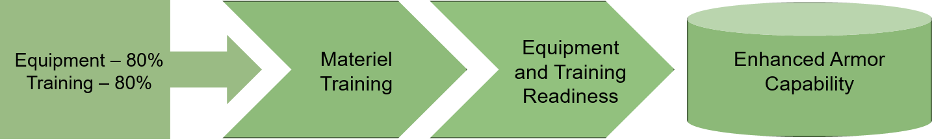
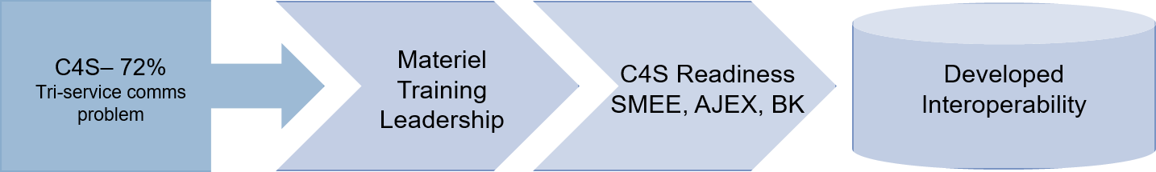
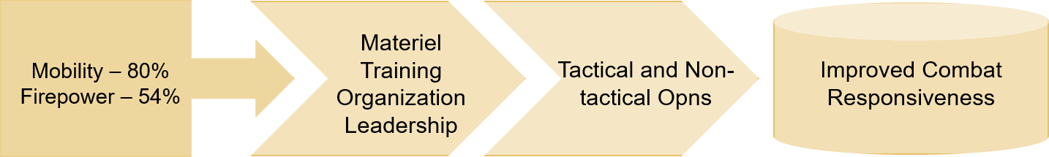
COMPLIANCES AND ACCOMPLISHMENTS TO DC’s GUIDANCE
UNIT OPERATIONAL DESIGN
Equipment-76.75
Training – 93%
C4S - 73%
Tri-Service comms
problem
Area Security
38%
Mobility – 82%
Firepower – 55%
Notes:
For the unit’s operational design please allow me to discuss the conceptual framework component of the unit’s operational design based on the unit’s performance scorecard and its corresponding value chains. The following are the conceptual desired conditions targeted to be accomplished through its respective approaches and focuses: (Click)
Firstly, the unit aims to enhance its armor capability. Currently, the unit’s equipment and training readiness are both at 80%. In order to steadily increase the unit’s equipment and training readiness the unit must exert efforts firstly in programming commercialized equipment for funding from APFs and SPFs from higher headquarters or fabrication of other required items such as the water dolly. While on training the unit must achieve all its training needs for the year and reach 100% both on its ORAC rating and METT Rating. (Click)
Secondly, the unit aims to have a developed interoperability condition primarily with the supported units and with other services to include PNP and other local security forces. One of the focuses will be on increasing the unit’s C4S capabilities particularly on communication equipment. Likewise, through adequate training and creative innovativeness in the leadership the unit aims to bridge the capability gaps causing the low interoperability. (Click)
And lastly, it is the goal of the unit to improve its combat responsiveness by providing timely and decisive cavalry capability to its supported units. Admittedly, the unit has very low, if not zero, control over the increase on its mobility and firepower readiness conditions. However, this will be compensated by its organizational capabilities and leadership. (Click)

Slide 36
COMPLIANCES AND ACCOMPLISHMENTS TO DC’s GUIDANCE
BEING RELEVANT ARMOR FORCE
NATIONAL AND LOCAL ELECTION 2022
Others
4%
68 PERSONNEL DEPLOYED DURING ELECTION
1 Officer & 67 Enlisted Personnel
Polling Center
Security
8%
Checkpoint
12%
Mobile Patrols
38%
2 POLLING CENTER SECURED
3 COMELEC CHECKPOINTS MANNED
Area Security
38%
Area Security
38%
Notes:
Shown on this slide is the infographics or summary of the activities conducted and personnel deployed during the National and Local Election. (Click)

Slide 37
COMPLIANCES AND ACCOMPLISHMENTS TO DC’s GUIDANCE
NATIONAL AND LOCAL ELECTION 2022
ACTIVITY | NR OF PERSONNEL DEPLOYED (OFFR/EP/CAA) | Nr of Activity
Polling Center Security | 6 | 2
Mobile Patrol (ICOW with Election) | 26 | 10
Area Security (Municipal Hall/Other Election areas) | 26 | 10
COMELEC Checkpoint | 7 | 3
Crowd Control | - | -
Other Election Related Activity | 2 | 1

Slide 38
COMPLIANCES AND ACCOMPLISHMENTS TO DC’s GUIDANCE
BEING RELEVANT ARMOR FORCE
COMBAT SCOREBOARD 2021 VS 2022
TACTICAL ACTIVITY
Area Security
Area Security

Slide 39
COMPLIANCES AND ACCOMPLISHMENTS TO DC’s GUIDANCE
BEING RELEVANT ARMOR FORCE
COMBAT SCOREBOARD 2021 VS 2022
TACTICAL ACTIVITY
ACTIVITY | 2021 | 2022 | % Change
Area Security | 2,540 | 4,289 | 168.9%
Checkpoint/Augmentation to checkpoint | 7 | 11 | 157.14%
Convoy / Escort Security | 15 | 36 | 240%
Logistics Run | 16 | 8 | 50%
Show of force | 66 | 22 | 33.33%
Mobile Patrol | 67 | 22 | 32.82%
Security augmentation | 42 | 57 | 135.71%
Security of vital installation | 6 | 79 | 1316.67%
VIP security | 6 | 10 | 166.67%
TOTAL | 2,765 | 4,534

Slide 40
COMPLIANCES AND ACCOMPLISHMENTS TO DC’s GUIDANCE
BEING RELEVANT ARMOR FORCE
NON-TACTICAL ACTIVITY 2021 vs 2022
Highest Conducted
Least Conducted

Slide 41
COMPLIANCES AND ACCOMPLISHMENTS TO DC’s GUIDANCE
BEING RELEVANT ARMOR FORCE
NON-TACTICAL ACTIVITY
ACTIVITY | 2021 | 2022 | % Change
Admin Movement | 34 | 23 | 67.64%
Camp Defense Dry Run | 3 | 6 | 200%
Ceremony / Honors | 18 | 24 | 133.33%
CMO Related Activities | 21 | 18 | 85.71%
Civic Military Parade | 2 | 2 | 100%
Conference | 22 | 29 | 131.l82%
Fire Drill | 4 | 6 | 150%
Maintenance / Check –up and Servicing | 1,064 | 2,246 | 214.72%
Personnel Cargo Transport | 9 | 15 | 166.66%
Ranks, Barracks & Vehicle | 2 | 33 | 1,650%
SUB-TOTAL | 1,179 | 2,400

Slide 42
COMPLIANCES AND ACCOMPLISHMENTS TO DC’s GUIDANCE
BEING RELEVANT ARMOR FORCE
NON-TACTICAL ACTIVITY
ACTIVITY | 2021 | 2022 | % Change
Ranks, Barracks & Vehicle | 2 | 33 | 1,650%
Refuel | 71 | 82 | 115.49%
Road test | 111 | 45 | 40.54%
Showdown Inspection | 8 | 19 | 237.5%
SQT/TDG | 3 | 231 | 7,700%
Static Display | 20 | 21 | 105%
Test Fire | 2 | 3 | 150%
Training Aid | 12 | 12 | 100%
Visit to Subordinate Unit/Detachment | 8 | 12 | 150%
SUB-TOTAL | 237 | 458
GRAND TOTAL | 1,416 | 2,858

Slide 43
COMPLIANCES AND ACCOMPLISHMENTS TO DC’s GUIDANCE
LOGISTICS READINESS
READINESS SUMMARY (CY 2021)
PARAMETERS |  |  |  |  | RATE (%) | REDCON
C. LOGISTICS
 | MOBILITY | FIREPOWER | C4S | QM
EQUIPMENT | 55% | 54% | 61% | 87% | MEE (80%) + SE (20%) | 64.25% / R3
MAINTENANCE | 100% | 100% | 99% | 100% | MEE (80%) + SE (20%) | 99.75% / R1
D. FACILITIES | Quantitative Rating (50%) |  | Qualitative Rating* (50%) |  |  | 98% / R1
Average REDCON (Total Rating/3) |  |  |  |  |  | 87.33% /R2
Over-All REDCON (Weakest Link) |  |  |  |  |  | 54% / R3
READINESS SUMMARY (CY 2022)
PARAMETERS |  |  |  |  | RATE (%) | REDCON
C. LOGISTICS
 | MOBILITY | FIREPOWER | C4S | QM
EQUIPMENT | 82% | 55% | 73% | 97% | MEE (80%) + SE (20%) | 76.75% / R3
MAINTENANCE | 100% | 100% | 80% | 100% | MEE (80%) + SE (20%) | 95% / R1
D. FACILITIES | Quantitative Rating (50%) |  | Qualitative Rating* (50%) |  |  | 98.5% / R1
Average REDCON (Total Rating/3) |  |  |  |  |  | 90.08% / R1
Over-All REDCON (Weakest Link) |  |  |  |  |  | 55% / R3

Slide 44
COMPLIANCES AND ACCOMPLISHMENTS TO DC’s GUIDANCE
EQUIPMENT READINESS RATING
R1
R2
R3

Slide 45
COMPLIANCES AND ACCOMPLISHMENTS TO DC’s GUIDANCE
JRRS COMPARATIVE TABLE CY 2021 & CY 2022
READINESS SUMMARY
CATEGORIES | Average REDCON CY 2021 (%) | Average REDCON CY 2022 (%) | % Difference
EQUIPMENT | 64.25% (R3) | 76.75% (R3) | 12.5%
MAINTENANCE | 99.75% (R1) | 95% (R1) | 4.75%
FACILITIES* | 98% (R1) | 98.5% (R1) | .5%
* FACILITIES - Computed through Qualitative Rating (50%) & Quantitative Rating (50%) of all units

Slide 46
COMPLIANCES AND ACCOMPLISHMENTS TO DC’s GUIDANCE
EQUIPMENT READINESS
PERIOD | MOBILITY |  | FIREPOWER
CURRENT (2022) | 82% | 27% | 55% | 1%
CY 2021 | 55% |  | 54%
LACKING FIREPOWER ASSETS
LACKING INDIVIDUAL FIRST AID KITS (IFAK), COMBAT LIFE SAVER (CLS) KITS AND COMBAT MEDICAL AIDMAN KITS
LACKING FORCE PROTECTION EQUIPMENT
REVISION/UPDATING OF JRRS TEMPLATE

Slide 47
COMPLIANCES AND ACCOMPLISHMENTS TO DC’s GUIDANCE
STATUS OF ARMORED VEHICLES
Date | Status |  |  | TOTAL
 | G | Y | R
CY 2021 vs CY 2022
CY 2021 | 12 | 0 | 0 | 12
CY 2022 | 13 | 0 | 0 | 13
ASSESSMENT: This unit has no red and yellow status of Armored Vehicles for CY 2021 and 2022

Slide 48
COMPLIANCES AND ACCOMPLISHMENTS TO DC’s GUIDANCE
STATUS OF ADMIN VEHICLES
Date | Status |  |  | TOTAL
 | G | Y | R
CY 2021 vs CY 2022
CY 2021 | 3 | 0 | 0 | 3
CY 2022 | 3 | 0 | 0 | 3
ASSESSMENT: This unit has no red and yellow status of Armored Vehicles for CY 2021 and 2022

Slide 49
COMPLIANCES AND ACCOMPLISHMENTS TO DC’s GUIDANCE
STATUS OF MOUNTED ARMAMENTS
Date | OH | Status |  | TOTAL
 |  | SVC | UNSVC
CY 2021 |  | 19 | 0 | 19
CY 2022 |  | 21 | 0 | 21
ASSESSMENT:
.

Slide 50
COMPLIANCES AND ACCOMPLISHMENTS TO DC’s GUIDANCE
STATUS OF FIREPOWER
Date | OH | Status |  | TOTAL
 |  | SVC | UNSVC
CY 2021 | 93 | 93 | 0 | 93
CY 2022 | 92 | 92 | 0 | 92
ASSESSMENT:
.

Slide 51
COMPLIANCES AND ACCOMPLISHMENTS TO DC’s GUIDANCE
STATUS OF AMMUNITION
Date | OH | Status |  | TOTAL
 |  | SVC | UNSVC
CY 2021 | 183,389 | 183,389 | 0 | 184,458
CY 2022 | 182,264 | 182,264 | 1,125 | 183,389
ASSESSMENT: Status of ammunition for CY 2021, 183, 389 rds has serviceable and no unserviceable ammo for the CY 2022. The EOD Team inspected and surveyed the status of ammunition. 1,125 unserviceable rds, 98rds of Ctg Cal .50 Ball Linked and 1,027 rds of 5.56mm Ball.
.

Slide 52
COMPLIANCES AND ACCOMPLISHMENTS TO DC’s GUIDANCE
STATUS OF AMMUNITION 2021
Type Of Ammo | 2 Basic Load (BL) | Issued (I) | Stock (S) | Total On Hand (OH) (I+S) | Excess/ Short (OH - BL) | % Fill-Up (OH/BL)
Ctg, 9mm: Ball | 136 | 2,244 |  | 2,244
Ctg, Cal .45: Ball | 78 | 1,170 | 1,370 | 2,540
Ctg, 5.56mm; Ball M855 | 720 | 4,415 |  | 4,415
Ctg, 5.56mm; Ball M193 | 720 | 14,641 | 19,651 | 34,292
Ctg, 7.62mm, Ball
Ctg, 5.56mm, Linked |  |  | 12,000 | 12,000
Ctg, 7.62mm, Linked | 4,000 | 12,778 | 32,413 | 45,191
Ctg, Cal .30, Linked
Ctg, 40mm, Ball
Ctg, Cal .50, Linked | 4,000 | 26,521 | 59,607 | 86,128
Ctg, 25mm, Linked
Ctg, 40mm, Linked
Ctg, 60mm, HE
Ctg, 76mm, HE
Ctg, 120mm, HE
Others/Non TOE
RPG, HEAT

Slide 53
COMPLIANCES AND ACCOMPLISHMENTS TO DC’s GUIDANCE
STATUS OF AMMUNITION 2022
Type Of Ammo | 2 Basic Load (BL) | Issued (I) | Stock (S) | Total On Hand (OH) (I+S) | Excess/ Short (OH - BL) | % Fill-Up (OH/BL)
Ctg, 9mm: Ball | 136 | 2,244 |  | 2,244
Ctg, Cal .45: Ball | 78 | 1,170 | 1,370 | 2,540
Ctg, 5.56mm; Ball M855 | 720 | 4,415 |  | 4,415
Ctg, 5.56mm; Ball M193 | 720 | 14,641 | 19,651 | 34,292
Ctg, 7.62mm, Ball
Ctg, 5.56mm, Linked, M855 |  |  | 12,000 | 12,000
Ctg, 7.62mm, Linked | 4,000 | 12,778 | 32,413 | 45,191
Ctg, Cal .30, Linked
Ctg, 40mm, Ball
Ctg, Cal .50, Linked | 4,000 | 26,521 | 59,607 | 86,128
Ctg, 25mm, Linked
Ctg, 40mm, Linked
Ctg, 60mm, HE
Ctg, 76mm, HE
Ctg, 120mm, HE |  |  | 60 | 60
Others/Non TOE
RPG, HEAT

Slide 54
COMPLIANCES AND ACCOMPLISHMENTS TO DC’s GUIDANCE
STATUS OF AMMUNITION

Slide 55
COMPLIANCES AND ACCOMPLISHMENTS TO DC’s GUIDANCE
STATUS OF ARMORED VEHICLES ON YELLOW STATUS CY 2022
Type & Name of AV | Reason of Down-Grade | Date Down-Graded | Spare parts Req | Date Started Repair (FROM) | Date Started Repair (TO) | Remarks
STATUS OF ARMORED VEHICLES ON YELLOW STATUS CY 2021
Type & Name of AV | Reason of Down-Grade | Date Down-Graded | Spare parts Req | Date Started Repair (FROM) | Date Started Repair (TO) | Remarks

Slide 56
COMPLIANCES AND ACCOMPLISHMENTS TO DC’s GUIDANCE
POL (ADF, XCS, Lubricants except fleet cards)
ADF
PERIOD | ALLOCATION | CONSUMPTION | BALANCE
1ST QTR | 813,609.00 | 813,609.00 | 0
2ND QTR | 813,609.00 | 813,609.00 | 0
3RD QTR | 813,609.00 | 813,609.00 | 0
4TH QTR | 813,609.00 | 813,609.00 | 0
TOTAL | 3,254,436.00 | 3,254,436.00 | 0
XCS
PERIOD | ALLOCATION | CONSUMPTION | BALANCE
1ST QTR | 99,474.00 | 99,474.00 | 0
2ND QTR | 99,474.00 | 99,474.00 | 0
3RD QTR | 99,474.00 | 99,474.00 | 0
4TH QTR | 99,474.00 | 99,474.00 | 0
TOTAL | 397,896.00 | 397,896.00 | 0

Slide 57
COMPLIANCES AND ACCOMPLISHMENTS TO DC’s GUIDANCE
POL (ADF, XCS, Lubricants except fleet cards)
LUBRICANTS
PERIOD | ALLOCATION | CONSUMPTION | BALANCE
1ST QTR | 813,609.00 | 813,609.00 | 0
2ND QTR | 813,609.00 | 813,609.00 | 0
3RD QTR | 813,609.00 | 813,609.00 | 0
4TH QTR | 813,609.00 | 416,804.00 | 396,805.00
TOTAL | 3,254,436.00 | 2,857,631.00 | 396,805.00
Fleet Cards
PERIOD | ALLOCATION | CONSUMPTION | BALANCE
1ST QTR | 216,900.00 | 216,900.00 | 0
2ND QTR | 216,900.00 | 216,900.00 | 0
3RD QTR | 216,900.00 | 216,900.00 | 0
4TH QTR | 216,900.00 | 144,600.00 | 72,300.00
TOTAL | 867,600.00 | 795,300.00 | 72,300.00

Slide 58
COMPLIANCES AND ACCOMPLISHMENTS TO DC’s GUIDANCE
POL ALLOCATION
E-CARD LOAD |  | INDUSTRIAL ALLOCATION
AMOUNT | BALANCE | ADF | BALANCE | XCS | BALANCE
PHP 867,600.00 | 72,300 | 34,400 LTRS | 2,866 | 5,332 LTRS | 444
LUBRICANTS ALLOCATION
Rev-X HD SEA10 P18 | Ultron Extra 20W40 C12X1 | Blaze Racing Multigrade 20W40 C12X1 | Rev-X HD SEA40 C24X1 | Rev-X Trekker 15W40 C24X1 | Rev-X Premium 15W40 C12X1 | 2T PowerburnC24X1 | ATF Premium C24X1
4 | 0 | 144 | 480 | 0 | 144 | 0 | 288
Gear Oil GEP 140 C24X1 | Petron Grease MP3 C24X500g | GX 85W140 P18 | Blaze Racing Fully SYN 5W40 C12X1 | Rev-X Fully SYN SEA 5W40 C12X1 | Brake & Clutch Fluid 24x250ml
96 | 120 | 4 | 96 | 120 | 96

Slide 59
COMPLIANCES AND ACCOMPLISHMENTS TO DC’s GUIDANCE
STATUS OF POWER CONSUMPTION
MONTH | ALLOCATION | BILLING | KWH | PAYMENT | BALANCE | ARREARS | REMARKS
Jan | 39,996.00 | 3,346.48 | 225.00 | 3,346.48 | - | -13.38 | Paid
Feb |  | 1,606.69 | 186.00 | 1,606.69 | - | 1,726.31 | Paid
Mar |  | 1,921.63 | 221.00 | 1,921.63 | - | 1,411.37 | Paid
Apr |  | 2,237.59 | 234.00 | 2,237.59 | - | 1,095.59 | Paid
May |  | 1,900.59 | 208.00 | 1,900.59 | - | 1,432.41 | Paid
Jun |  | 2,511.39 | 217.00 | 2,511.39 | - | 821.61 | Paid
Jul |  | 2,590.46 | 241.00 | 2,590.46 | - | 742.54 | Paid
Aug |  | 2,378.78 | 205.00 | 2,378.78 | - | 954.22 | Paid
Sep |  | 2,350.11 | 225.00 | 2,350.11 | - | 982.89 | Paid
Oct |  | 1,667.59 | 178.02 | 1,667.59 | - | 1,665.41 | Paid
Nov |  | - | - | - | - | - | No Bill Yet
Dec |  | - | - | - | - | - | No Bill Yet
NOTE: 1. ALLOCATION AND BILLING / KWH ENTRIES SHOULD COVER THE ENTIRE CY 2022
2. REMARKS PORTION TO INCLUDE ACTIONS TAKEN TO SETTLE BALANCE /ARREARS

Slide 60
COMPLIANCES AND ACCOMPLISHMENTS TO DC’s GUIDANCE
LAND OWNERSHIP/STATUS OF CAMPS
UNIT | Location of Hqs & Detachments | Status of land Ownership | Terms of Agreement | Compliance to AREO | Action Taken
6CavCoy (S) | H6Cav Coy (S), Camp Peralta, Jamindan, Capiz |  | OPCON 3ID, PA
 | ACP, 6Cav Coy (S), Camp Hernandez, Dingle, Iloilo |  | OPCON 301st Bde, PA

Slide 61
COMPLIANCES AND ACCOMPLISHMENTS TO DC’s GUIDANCE
FACILITIES – R&U PROJECTS
Sptd by LOG MOOE
PERIOD | UNIT | NAME OF PROJECT | SCOPE OF WORK | APB PROG | ACTUAL COST | REMARKS
1ST QTR | 6Cav Coy (S) | Repair and maintenance of Billeting Facility | Installation Masonry and Carpentry of Billeting Facility | 10,000.00 | 10,050.00 | Completed
 | 6Cav Coy (S) | Repair and Maintenance of Base/Camp Security Facilities and defenses | Carpentry and Construction of perimeter fence | 15,000.00 | 15,000.00 | Completed
 | 6Cav Coy (S) | Repair and Maintenance of Comfort Room of Quarantine Facility | Carpentry and Construction of Comfort Room | 10,000.00 | 10,000.00 | Completed
 | 6Cav Coy (S) | Repair and Maintenance of Water System | Cleaning and Repainting of water tank | 15,000.00 | 15,000.00 | Completed
 | 6Cav Coy (S) | Repair and Maintenance of Mess Facility | Repair, Carpentry and Masonry of Mess Facility | 5,000.00 | 5,000.00 | Completed

Slide 62
COMPLIANCES AND ACCOMPLISHMENTS TO DC’s GUIDANCE
FACILITIES – R&U PROJECTS
Sptd by LOG MOOE
PERIOD | UNIT | NAME OF PROJECT | SCOPE OF WORK | APB PROG | ACTUAL COST | REMARKS
2ND QTR | 6Cav Coy (S) | Repair and maintenance of Billeting Facility | Continue Masonry and Carpentry of Billeting Facility | 10,000.00 | 10,005.00 | Completed
 | 6Cav Coy (S) | Repair and Maintenance of Base/Camp Security Facilities and defenses | Repainting of perimeter fence | 15,000.00 | 15,039.00 | Completed
 | 6Cav Coy (S) | Repair and Maintenance of Mess Facility | Repair, Carpentry and Masonry of Mess Facility | 5,000.00 | 5,000.00 | Completed
3RD QTR | 6Cav Coy (S) | Repair and Maintenance of Base/Camp Security Facilities and defenses | Repair Construct and replaced of old perimeter fence | 15,000.00 | 15,000.00 | Completed
 | 6Cav Coy (S) | Repair and Maintenance of Mess Facility | Repair, Carpentry and Masonry of Mess Facility | 5,000.00 | 5,000.00 | Completed
 | 6Cav Coy (S) | Repair and maintenance of Billeting Facility | Masonry and Carpentry of Billeting Facility | 10,000.00 | 10,005.00 | Completed

Slide 63
COMPLIANCES AND ACCOMPLISHMENTS TO DC’s GUIDANCE
FACILITIES – R&U PROJECTS
Sptd by LOG MOOE
PERIOD | UNIT | NAME OF PROJECT | SCOPE OF WORK | APB PROG | ACTUAL COST | REMARKS
4TH QTR | 6Cav Coy (S) | Repair and Maintenance of Base/Camp Security Facilities and defenses | Repair Construction and replacement of old perimeter fence | 15,000.00 | 15,000.00 | Completed
 | 6Cav Coy (S) | Repair and Maintenance of Mess Facility | Repair, Carpentry and Masonry of Mess Facility | 5,000.00 | 5,000.00 | Completed
 | 6Cav Coy (S) | Repair and maintenance of Billeting Facility | Masonry and Carpentry of Billeting Facility | 10,000.00 | 10,005.00 | Completed

Slide 64
COMPLIANCES AND ACCOMPLISHMENTS TO DC’s GUIDANCE
STATUS OF REGISTRATION OF ADMIN VEHICLES
L/I | NOMENCLATURE | REMARKS/Action taken
1 | KM450 1 ¼ Ton Truck | Not Registered
1 | Truck M35 2 ½ Ton | Not Registered
1 | Truck 5 Tonner | Not Registered

Slide 65
COMPLIANCES AND ACCOMPLISHMENTS TO DC’s GUIDANCE
STATUS OF FIREPOWER ASSETS (INDIVIDUAL WEAPONS)
*TYPE OF FA | ISSUED |  | STOCK |  | SVCBILITY % | NR OF AVAIL AMMO |  | REMARKS
 | SVCBLE | UNSVCBLE & DATE UNSVCBLE | SVCBLE | UNSVCBLE & DATE UNSVCBLE |  | ISSUED | STOCK
Pistol, Cal .45/RIA | 29 |  |  |  | 100% | 1,053 | -
Pistol, Glock 17, 9mm | 30 |  |  |  | 100% | 1,564 | -
Carbine, 5.56mm R4A3 | 31 |  | 41 |  | 100% | 18,097 | 19,430
Carbine, 5.56mm M4 | -
Rifle, 5.56mm M16A1 | -
SMG, 5.56mm M653 | -
SMG, Cal .45 | -
Rifle, 7.62mm M14 | -
DMR, 7.62mm | -
GL, 40mm M203 | -
AGL, 40mm | -
RPG Type 69, 40mm | -
SAW, 5.56mm K3 |  |  | 2 |  | 100% |  | 12,000

Slide 66
COMPLIANCES AND ACCOMPLISHMENTS TO DC’s GUIDANCE
STATUS OF FIREPOWER ASSETS (CREW-SERVED WEAPONS)
*TYPE OF FA | ISSUED |  | STOCK |  | SVCBILITY % | NR OF AVAIL AMMO |  | REMARKS
 | SVCBLE | UNSVCBLE & DATE UNSVCBLE | SVCBLE | UNSVCBLE & DATE UNSVCBLE |  | ISSUED | STOCK
LMG, Cal .30 | - |  | -
LMG/GPMG, 7.62mm M60/M60E3 | 8 |  | 2 |  | 100% | 13,843 | 31,408 | Svble
HMG, Cal .50 | 12 |  | - |  | 100% | 23,358 | 62,699 | Svble
Mortar, 60mm | - |  | -
Mortar, 81mm | - |  | -
Gun, 76mm | - |  | -
Cannon, 25mm | - |  | -
Cannon, 20mm | - |  | -

Slide 67
COMPLIANCES AND ACCOMPLISHMENTS TO DC’s GUIDANCE
STATUS OF SPECIAL EQUIPMENT
TYPE OF EQUIPMENT | SVCBLE | UNSVCBLE/ DATE UNSVCBLE | SVC %
Night Vision Device (NVD) | - | -
Infrared Aiming Device (IRAD) | - | -
Laser Zeroing Device (LZD) | - | -
Thermal Scope | - | -
Thermal Imaging Camera | - | -
GPS, Handheld | 9 | - | 100%
GPS, Fit Airborne | - | -
Binocular | 7 | - | 100%
Compass | - | -

Slide 68
COMPLIANCES AND ACCOMPLISHMENTS TO DC’s GUIDANCE
STATUS OF SPECIAL EQUIPMENT
TYPE OF EQUIPMENT | TOE | ON HAND | SVCBLE | UNSVC | SVCBLTY PERCENTAGE | REMARKS
Lensatic Compass | 10 | 20 |  |  | 100%
Binocular | 10 | 7 |  |  | 100%
Arm Rack |  | 5 |  |  | 100%
Battery Charger |  | 1 |  |  | 100%
Battery Load Tester |  | -
Body Jack 4 Ton |  | 2 |  |  | 100%
Helmet (Ballistic) | 94 | 61 |  |  | 100%
Military Body Armor | 94 | 91 |  |  | 100%
Vest | - | -
CLS Kit |  | 4 |  |  | 100%
Snap On Tools | 1 | 1 |  |  | 100%
Tent (Troop Hutment) | 1 | 1 |  |  | 100%
Water Trailer (400 Gal) | 1 | 1 |  |  | 100%

Slide 69
COMPLIANCES AND ACCOMPLISHMENTS TO DC’s GUIDANCE
STATUS OF SPECIAL EQUIPMENT
TYPE OF EQUIPMENT | TOE | ON HAND | SVCBLE | UNSVC | SVCBLTY PERCENTAGE | REMARKS
Generator Set | 1 | 1 | 1 |  | 100%
Fuel Pump Manual | 2 | 3 | 3 |  | 100%
Tool Set (Level 2)
Tool Set (Level 3) | 7 | 4 | 4 |  | 100%
Welding Acetylene |  | 1 | 1 |  | 100%

Slide 70
COMPLIANCES AND ACCOMPLISHMENTS TO DC’s GUIDANCE
Programmed C4S activities based on Approved APB/PAPs CY 2022
UNIT | PAPs | TARGETS PER QTR |  |  |  | COMPLIED
 |  | 1st Qtr | 2nd Qtr | 3rd Qtr | 4th Qtr | 1st Qtr | 2nd Qtr | 3rd Qtr | 4th Qtr
6Cav Coy (S) | SP33.6 RM of IT Equipment | 0 | 1 | 0 | 1 | - | 1 | - | 1
 | SP43.7 Subscription of Internet Services | 3 | 3 | 3 | 3 | 3 | 3 | 3 | 2
 | SP43.8 Subscription of Cable Services | 3 | 3 | 3 | 3 | 3 | 3 | 3 | 2
 | SP43.5 Subscription of Communication Services (Mobile) | 3 | 3 | 3 | 3 | 3 | 3 | 3 | 2
TOTAL |  | 9 | 10 | 9 | 10 | 9 | 10 | 9 | 7
Notes:
Moving on to C4S, the unit has a total of 14 activities completed for this semester with complete AARs and FURs. (Click)

Slide 71
COMPLIANCES AND ACCOMPLISHMENTS TO DC’s GUIDANCE
STATUS OF C4S EQUIPMENT
C4S READINESS |  | 2021 |  | 2022
 |  | RATE (%) | REDCON | RATE (%) | REDCON
EQUIPMENT | 1ST QTR | 54% | R4 | 73% | R3
 | 2ND QTR | 54% | R3 | 73% | R3
 | 3RD QTR | 62% | R3 | 73% | R3
 | 4TH QTR | 61% | R3 | 73% | R3
MAINTENANCE | 1ST QTR | 96% | R1 | 100% | R1
 | 2ND QTR | 100% | R1 | 82% | R2
 | 3RD QTR | 100% | R1 | 78% | R2
 | 4TH QTR | 99% | R1 | 80% | R2
Notes:
Moving on to C4S, the unit has a total of 14 activities completed for this semester with complete AARs and FURs. (Click)

Slide 72
COMPLIANCES AND ACCOMPLISHMENTS TO DC’s GUIDANCE
CAV COY STATUS OF C4S EQUIPMENT
NOMENCLATURE | TOE | 2021 |  |  |  |  |  |  |  |  |  |  |  | 2022
 |  | ON-HAND |  |  |  |  |  |  |  |  | TOTAL |  |  | ON-HAND |  |  |  |  |  |  |  |  | TOTAL
 |  | GREEN |  |  | YELLOW |  |  | RED |  |  |  |  |  | GREEN |  |  | YELLOW |  |  | RED
JRRS PER QUARTER |  | 1 | 2 | 3 | 1 | 2 | 3 | 1 | 2 | 3 | 1 | 2 | 3 | 1 | 2 | 3 | 1 | 2 | 3 | 1 | 2 | 3 | 1 | 2 | 3
HF 20W Manpack Radio | 1 | 2 | 2 | 2 |  |  |  |  |  |  | 2 | 2 | 2 | 2 |  |  |  | 2 | 2 |  |  |  | 2 | 2 | 2
VHF 2-50W Vehicular Radio | 26 | 12 | 12 | 12 |  |  |  |  |  |  | 12 | 12 | 12 | 12 | 8 | 8 |  | 4 | 4 |  |  |  | 12 | 12 | 12
VHF 2-10W Handheld Radio | 20 | 10 | 10 | 10 |  |  |  |  |  |  | 10 | 10 | 10 | 10 | 5 | 5 |  |  |  |  | 5 | 5 | 10 | 10 | 10
Night Vision Device (NVD) | 25
Infra-Red Aiming Device (IRAD) | 25
Laser Zeroing Device (IRAD) | 3
Thermal Scope | 1
Thermal Imaging Camera | 1
Optic Sight | 4
OS (Licensed) | 5 | 2 | 2 | 4 |  |  |  |  |  |  | 2 | 2 | 4 | 7 | 7 | 7 |  |  |  |  |  |  | 7 | 7 | 7
GPS, Handheld | 10 | 2 | 2 | 2 |  |  |  |  |  |  | 2 | 2 | 2 | 9 | 9 | 9 |  |  |  |  |  |  | 9 | 9 | 9
Desktop Computer | 4 | 3 | 3 | 3 |  |  |  |  |  |  | 3 | 3 | 3 | 6 | 6 | 6 |  |  |  |  |  |  | 6 | 6 | 6
Laptop Computer | 1 |  | 1 | 1 |  |  |  | 1 |  |  | 1 | 1 | 1 | 1 | 1 | 1 |  |  |  |  |  |  | 1 | 1 | 1
Multi Media Projector | 1 | 1 | 1 | 1 |  |  |  |  |  |  | 1 | 1 | 1 | 1 | 1 | 1 |  |  |  |  |  |  | 1 | 1 | 1
Printer (with or without Scanner) | 2 | 3 | 3 | 4 |  |  |  |  |  |  | 3 | 3 | 4 | 5 | 5 | 5 |  |  |  |  |  |  | 5 | 5 | 5
Digital Camera | 1 | 1 | 1 | 1 |  |  |  |  |  |  | 1 | 1 | 1 | 1 | 1 |  |  |  |  |  |  | 1 | 1 | 1 | 1
PAS Class C (300W) | 2 | 1 | 1 | 1 |  |  |  |  |  |  | 1 | 1 | 1 | 2 | 2 | 2 |  |  |  |  |  |  | 2 | 2 | 2
Notes:
Moving on to C4S, the unit has a total of 14 activities completed for this semester with complete AARs and FURs. (Click)

Slide 73
COMPLIANCES AND ACCOMPLISHMENTS TO DC’s GUIDANCE
CAV COY STATUS OF C4S EQUIPMENT
NOMENCLATURE | STATUS OF C4S EQUIPMENT 2021 |  |  |  |  |  | STATUS OF C4S EQUIPMENT 2022
 | EQUIPMENT READINESS |  |  | MAINTENANCE READINESS |  |  | EQUIPMENT READINESS |  |  | MAINTENANCE READINESS
 | 1st QTR | 2nd QTR | 3rd QTR | 1st QTR | 2nd QTR | 3rd QTR | 1st QTR | 2nd QTR | 3rd QTR | 1st QTR | 2nd QTR | 3rd QTR
JRRS PER QUARTER | 54% | 54% | 62% | 96% | 100% | 100% | 73% | 73% | 73% | 100% | 82% | 78%
HF 20W Manpack Radio | 100% | 100% | 100% | 100% | 100% | 100% | 100% | 100% | 100% | 100% | 100% | 0%
VHF 2-50W Vehicular Radio | 46% | 46% | 46% | 100% | 100% | 100% | 46% | 46% | 46% | 100% | 67% | 67%
VHF 2-10W Handheld Radio | 50% | 50% | 50% | 100% | 100% | 100% | 50% | 50% | 50% | 100% | 50% | 50%
Night Vision Device (NVD)
Infra-Red Aiming Device (IRAD)
Laser Zeroing Device (IRAD)
Thermal Scope
Thermal Imaging Camera
Optic Sight
OS (Licensed) | 40% | 40% | 80% | 100% | 100% | 100% | 100% | 100% | 100% | 100% | 100% | 100%
GPS, Handheld | 20% | 20% | 20% | 100% | 100% | 100% | 90% | 90% | 90% | 100% | 100% | 100%
Desktop Computer | 75% | 75% | 75% | 100% | 100% | 100% | 100% | 100% | 100% | 100% | 100% | 100%
Laptop Computer | 100% | 100% | 100% | 0% | 100% | 100% | 100% | 100% | 100% | 100% | 100% | 100%
Multi Media Projector | 100% | 100% | 100% | 100% | 100% | 100% | 100% | 100% | 100% | 100% | 100% | 100%
Printer (with or without Scanner) | 100% | 100% | 100% | 100% | 100% | 100% | 100% | 100% | 100% | 100% | 100% | 100%
Notes:
Moving on to C4S, the unit has a total of 14 activities completed for this semester with complete AARs and FURs. (Click)

Slide 74
COMPLIANCES AND ACCOMPLISHMENTS TO DC’s GUIDANCE
JOINT READINESS REPORTING SYSTEM (OPREVAL)
NR | UNIT | C4S Equipment Readiness Condition |  |  |  | C4S Maintenance Readiness Condition
NR | UNIT | 2021 |  | 2022 |  | 2021 |  | 2022
 |  | Percentage | Status | Percentage | Status | Percentage | Status | Percentage | Status
1 | 6Cav Coy (S) | 61% | R3 | 73% | R3 | 99% | R1 | 80% | R2
Assessment: Equipment readiness in terms of C4S increased slightly after the procurement of three (3) Raspberry Pi computer sets with genuine operating system and fabrication of additional 300W PAS as required on the unit’s TOE. The decreased percentage on maintenance readiness of this unit is due to the yellow status of four (4) AV Radio Intercom System while two (2) Manpack and five (5) HH5800 are on red status.
Notes:
Shown on this slide are the C4S equipment and maintenance readiness of the unit. Equipment readiness in terms of C4S increased by slightly after the procurement of three (3) Raspberry Pi computer sets with genuine operating systems and fabrication of additional 300W PAS as required on the unit’s TE. While on maintenance readiness this unit ensures the high percentage in order to fully support the move-shoot-communicate requirements of every AV. (Click)

Slide 75
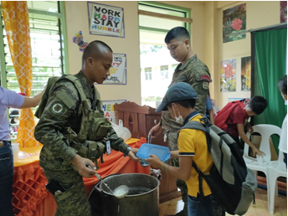
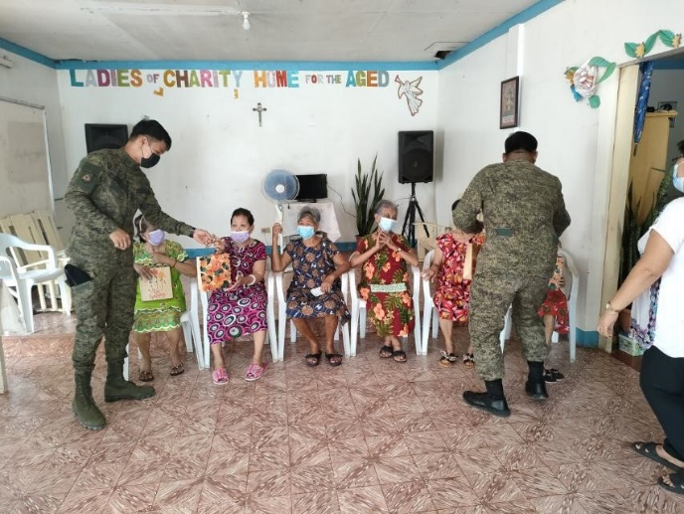
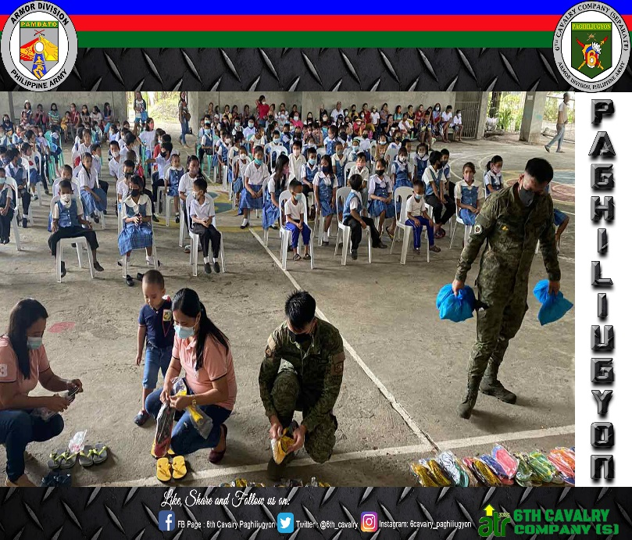
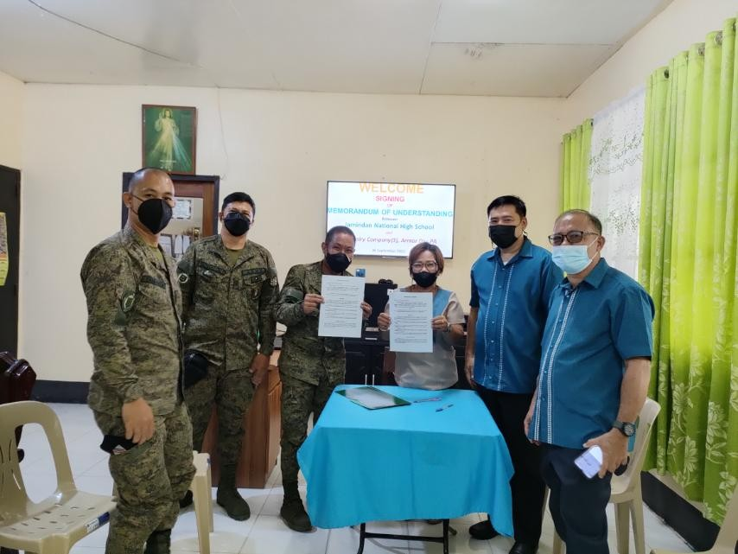
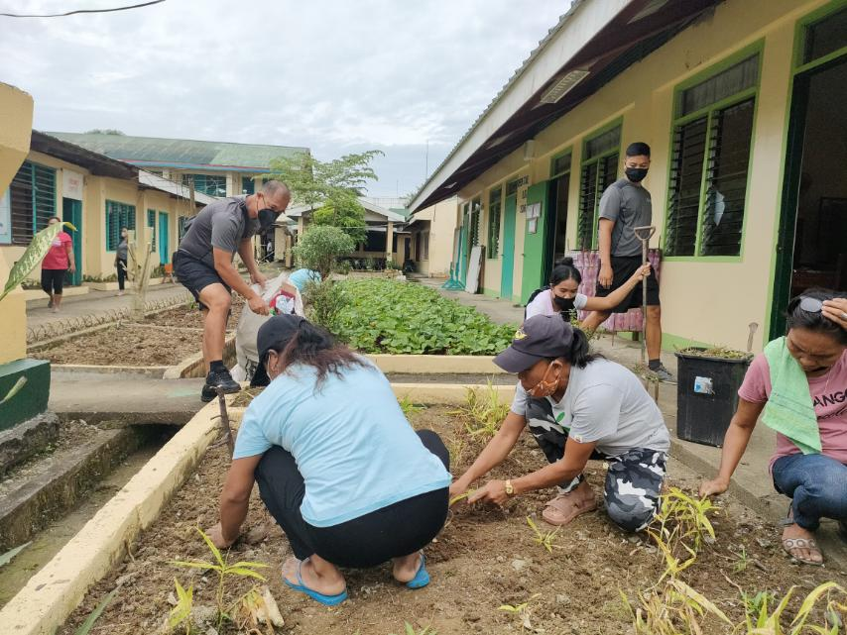
COMPLIANCES AND ACCOMPLISHMENTS TO DC’s GUIDANCE
PURSUE FOCUSED AND PURPOSIVE CMO
Notes:
On CMO, the unit has significant increase in the number of activities attributable to information or psychological operations to include show-of-force/mobile patrols, distribution of leaflets, social media presence and development of unit‘s official website etc. On civil affairs such as Outreach programs and CMO Projects all targets have been completed. Recently, the unit conducted “Brigada Eskwela” to various schools within the periphery of 3ID, PA. (Click)

Slide 76
COMPLIANCES AND ACCOMPLISHMENTS TO DC’s GUIDANCE
GENERAL ACTIVITIES
CMO PILLARS | 2021 |  | 2022 |  | Remarks
 | Target (APB CY 2021) | Actual CY 2021 | Target (APB CY 2022) | Actual CY 2022
PsyOps | 12 | 12 | 25 | 25 | PsyOps of this unit include show-of-force/mobile patrols, distribution of leaflets, social media presence and development of unit‘s official website etc.
Civil Affairs | 1 | 1 | 6 | 6 | Outreach Programs, “Battle for Bottle” Project among others
Public Affairs | 8 | 8 | 6 | 5 | Tree Planting, Brigada Eskwela etc.
Notes:
On CMO, the unit has significant increase in the number of activities attributable to information or psychological operations to include show-of-force/mobile patrols, distribution of leaflets, social media presence and development of unit‘s official website etc. On civil affairs such as Outreach programs and CMO Projects all targets have been completed. Recently, the unit conducted “Brigada Eskwela” to various schools within the periphery of 3ID, PA. (Click)

Slide 77
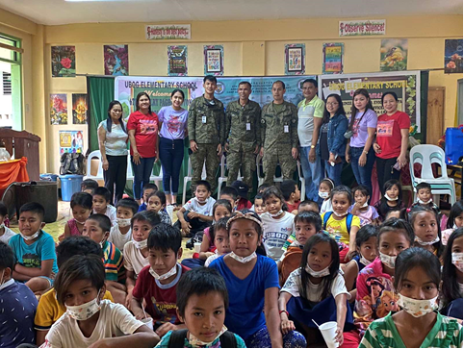
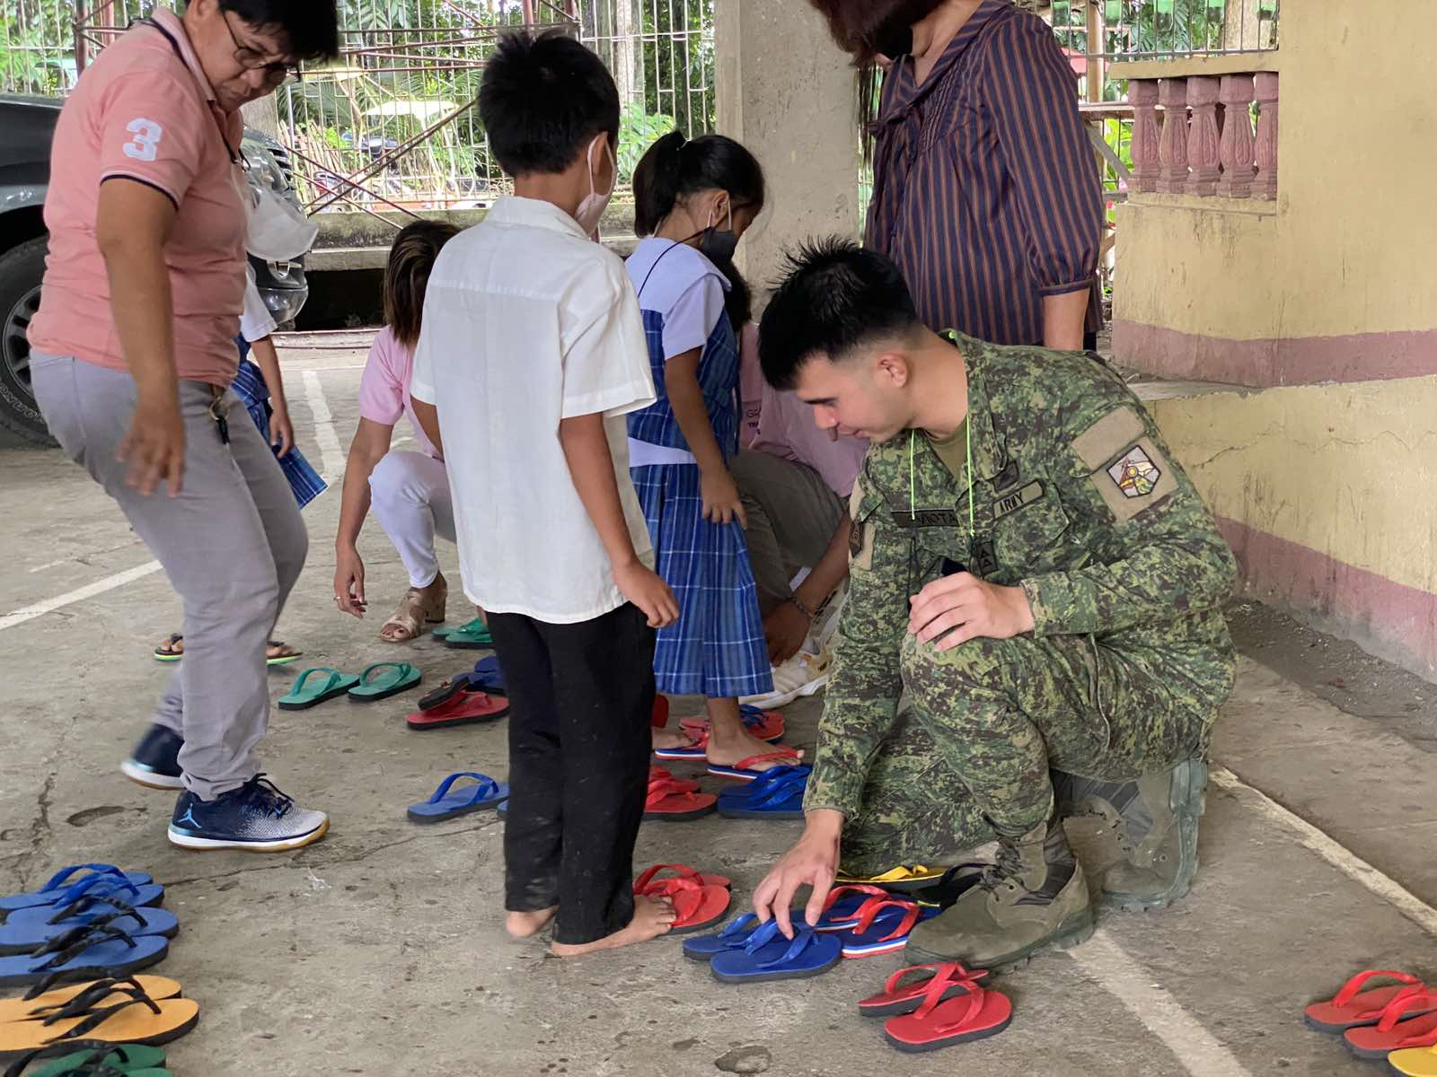
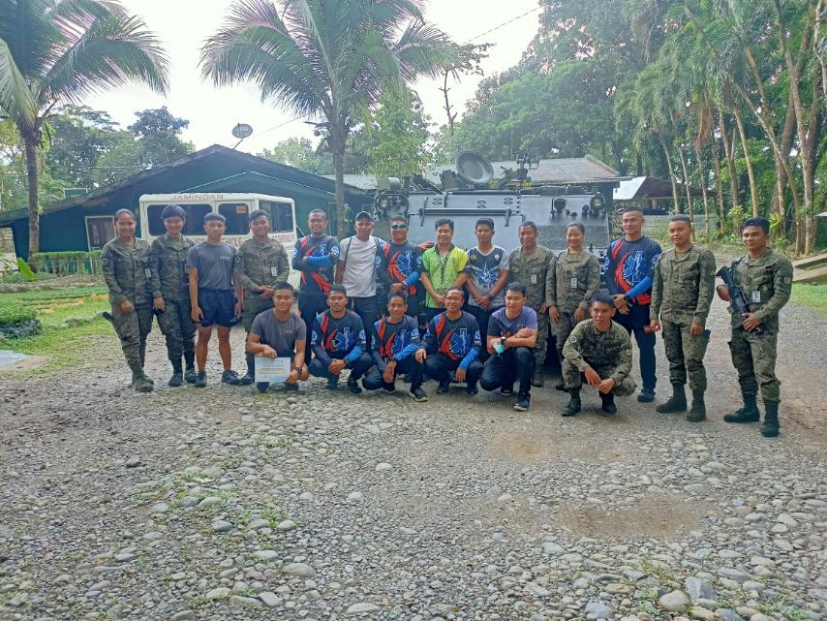
COMPLIANCES AND ACCOMPLISHMENTS TO DC’s GUIDANCE

Slide 78
COMPLIANCES AND ACCOMPLISHMENTS TO DC’s GUIDANCE
OTHER ACTIVITIES
CY 2021
Activities | Target | Conducted | % Accom | Remarks
NGP | 6 | 6 | 100% | Completed
PEACE PROCESS | - | - | - | -
NATION BUILDING | - | - | - | -
2022
Activities | Target | Conducted | % Accom | Remarks
NGP | 4 | 4 | 100% | Completed
PEACE PROCESS | - | - | - | -
NATION BUILDING | - | - | - | -
Notes:
On other CMO Activities, the unit supports the National Greening Program through various activities such as planting of fruit-bearing trees. All personnel of the unit are required to plant at least three fruit-bearing trees. (Click)

Slide 79
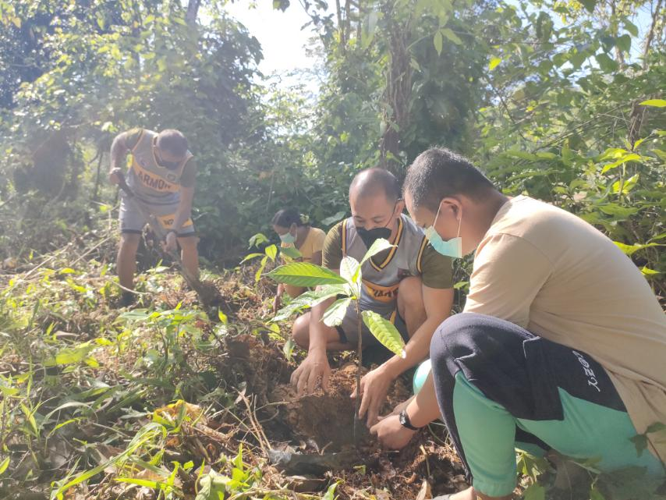
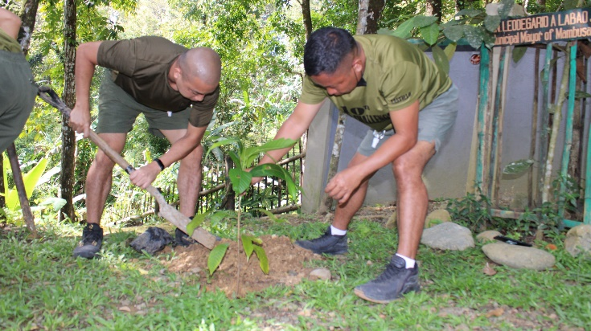

COMPLIANCES AND ACCOMPLISHMENTS TO DC’s GUIDANCE

Slide 80
COMPLIANCES AND ACCOMPLISHMENTS TO DC’s GUIDANCE
READINESS SUMMARY IN TRAINING
CY | ORAC |  |  | METT |  |  | RATING (%) | REDCON
 | Nr of Assigned Crew | Nr of ORAC | ORAC Rating (%) | Nr of METT with required Training | Nr of METT addressed | METT Rating (%)
2021 | 75 | 75 | 40% | 8 | 8 | 60% | 100% | R1
2022 | 79 | 79 | 40% | 8 | 8 | 53% | 93% | R1
Assessment: The Mission essential tasks trained (METT) of this unit is 53% as of 4th Quarter 2022. This unit has already program training for Observed Fire Procedure Training to increase METT next year.

Slide 81
COMPLIANCES AND ACCOMPLISHMENTS TO DC’s GUIDANCE
RECAP OF PROGRAM VS ACTUAL CY 2021 & 2022
TRAININGS | CY 2021 |  | CY 2022
 | PROGRAMMED | ACTUAL | PROGRAMMED | ACTUAL
IN-HOUSE | 8 | 8 | 8 | 8
IN-SERVICE | 4 | 1 | 4 | 2
ANNUAL MARKSMANSHIP TRNG | 1 | 1 | 1 | 1
SWEEP | 1 | 1 | 1 | 1
BCAT | - | - | - | -
BRP | - | - | - | -
PRE-ENTRY | - | - | - | -
SERVICE COURSES | - | - | - | -
DIRECTED BY HIGHER HQS | - | - | 4 | 4
TOTAL | 14 | 11 | 18 | 16

Slide 82
COMPLIANCES AND ACCOMPLISHMENTS TO DC’s GUIDANCE
STATUS OF TRAINING PROGRAMS
TYPE | TITLE | MONTH | STATUS | REMARKS
In-House | TLP/Mission Planning Exercise Training | February | Completed | Completed on 17 Feb 22
 | Basic Medical Aidman Training | March | Completed | Completed on 14 Mar 22
 | AFV Gunnery & Maintenance Training | April | Completed | Completed on 15 April 22
 | NCO Leadership Training | May | Completed | Completed on 13 May 22
In-Service | SFV Defensive Driving Training | April | Completed | Completed on 15 April 22
 | AFV Mounted Weapons Training | Nov | Completed | Completed on 09 Nov 22
SWEEP | SWEEP | July | Completed | Completed on 19 Sep 22
Marksmanship | AMTP – Rifle, Pistol and other Weapons | August | Completed | Completed on 19 Sep 22

Slide 83
COMPLIANCES AND ACCOMPLISHMENTS TO DC’s GUIDANCE
SUMMARY OF ALLOTMENT
UNIT | ALLOTMENT
 | 2021 | 2022
REGULAR MOOE | 1,000,000.00 | 1,000,000.00
APF | 271,625.00 | 225,000.00
SPF | 297,800.00 | 247,160.00
PAWAF | 900,990.00 | 735,449.00
OHER FUNDS,OSS,IAFT | - | 243,800.00
TOTAL | 2,470,415.00 | 2,451,409.00

Slide 84
COMPLIANCES AND ACCOMPLISHMENTS TO DC’s GUIDANCE
(FY2021) FINANCIAL PERFORMANCE
Organic Units - Allotment, Obligation, Disbursement
Category | Allotment | Obligation | Obligation Rate (%) | Unobligated | Disbursement | Disbursement Rate (%) | Undisbursed
Regular MOOE | 1,000,000.00 | 1,000,000.00 | 100% | - | 1,000,000.00 | 100% | -
APF | 271,625.00 | 271,625.00 | 100% | - | 271,625.00 | 100% | -
SPF | 297,800.00 | 297,800.00 | 100% | - | 297,800.00 | 100% | -
PAWAF | 900,990.00 | 900,990.00 | 100% | - | 900,990.00 | 100% | -
Total | 2,470,415.00 | 2,470,415.00 | 100% |  | 2,470,415.00 | 100%

Slide 85
COMPLIANCES AND ACCOMPLISHMENTS TO DC’s GUIDANCE
(FY2022) FINANCIAL PERFORMANCE
Organic Units - Allotment, Obligation, Disbursement
Category | Allotment | Obligation | Obligation Rate (%) | Unobligated | Disbursement | Disbursement Rate (%) | Undisbursed
Regular MOOE | 1,000,000.00 | 1,000,000.00 | 100% | - | 1,061,125.00 | 96.11% | 38,875.00
APF | 225,000.00 | 225,000.00 | 100% | - | 225,000.00 | 100% | -
SPF | 147,160.00 | 147,160.00 | 100% | - | 147,160.00 | 100% | -
PAWAF | 735,449.00 | 735,449.00 | 100% | - | 735,449.00 | 100% | -
Total | 2,107,609.00 | 2,107,609.00 | 100% |  | 2,168,734.00

Slide 86
COMPLIANCES AND ACCOMPLISHMENTS TO DC’s GUIDANCE
FY 2022 FINANCIAL PERFORMANCE
Organic Units - Allotment, Obligation, Disbursement
Funds | Total Cash Advances | Liquidations | Outstanding Balance | Ageing
 |  |  |  | Not Yet Due | Less than a Yr | More than a Yr but less than 3Yrs | More than 3Yrs but less than 5Yrs | More than 5Yrs
 | (as of the period in review)
Advances for Operating Expenses | 2,451,409.00 | 2,412,534.00 | 38,875.00 | - | - | - | - | -
Total | 2,451,409.00 | 2,412,534.00 | 38,875.00 | - | - | - | - | -
LIQUIDATION RATE | 96.11%

Slide 87
COMPLIANCES AND ACCOMPLISHMENTS TO DC’s GUIDANCE
PARAMETER | 2021 | 2022 | REMARKS
a. Obligation Rate (Obr) – measuring the financial performance of Post and Line Units in terms of thier onligation vis-avis regular allotment/ other releases Formula: Obligation X 100 Total Allotment | 100% | 100% | The unit is still yet to complete the disbursement for 4th Qtr 2022.
b. Disbursement Rate (DR) – financial performance of Post and Line Units in terms of their disbursement. Formula: Disbursement X 100 Total Obligation | 100% | 96.46%
c. Liquidation Rate – Cash Advances (LR) – refers to the liquidated cash advances vis-avis total cash advances made by unit accountable officers for the period Formula: Liquidation X 100 Total Cash Advance | 100% | 96.11%

Slide 88
COMPLIANCES AND ACCOMPLISHMENTS TO DC’s GUIDANCE
ATR PARAMETERS
SUBMISSION STATUS OF UNITS
RECURRING REPORTS
Parameters | Number of Reports Required | CY 2021 | CY 2022
STRATEGY REVIEW | 3 | 4 | 3
PROGRAMS REVIEW | 11 | 12 | 10
ACTION PLAN PROGRESS REPORT | 2 | 2 | 1
PERSONAL SCORECARD REPORT | 11 | 12 | 10
PS DAY | 11 | 12 | 10
ATR ACTION PLAN | 1 | 1 | 1

Slide 89
COMPLIANCES AND ACCOMPLISHMENTS TO DC’s GUIDANCE
ATR PARAMETERS
SUBMISSION STATUS OF UNITS
ADHERENCE TO INDICATIVE TIMELINE
Initiated Status Date Conferred | Compliant Status Date Conferred | Proficient Status Date Conferred | Institutionalized Stage Bid Status/ Date of Conferral
Nov 2015 | June 2016 | Oct 2020 | Ongoing Validation
FUNCTIONALITY OF PERSONAL SCORECARD 2022
IST SEMESTER |  |  | 2ND SEMESTER
G | Y | R | G | Y | R
71.8% | 12.7% | 15.4% | 85.33% | 5.26% | 9.39%

Slide 90
COMPLIANCES AND ACCOMPLISHMENTS TO DC’s GUIDANCE
ARMY GOVERNANCE PATHWAY IMPLEMENTATION AND SUSTAINMENT
Data | Remarks
Mission Accomplishment Readiness Condition Character Development | BTG1: Increase number of Tactical and Non-Tactical Operations in support to JTF “Spear”, 3ID (Armor Training and Capability Enhancement Program) BTG2: Increase in Personnel Qualification Rating Index from 80% to 82% by 2022 (Personnel Enhancement Program) BTG3: Increase in percentage of functionality of personal governance scorecard from 80% to 85% by 2022
BTG Statuses | BTG1: 100%. There has been significant increase in tactical and non-tactical operations since June 2021 from 46% to 266.6%. BTG2: 97.5%. PQRI of this unit now at 80%, due to rotation of personnel. BTG3: 100%. This Unit has already achieved the target for this BTG.
Way Forward based on AGP Timeline set by GSMO | 6Cav Coy (S) is currently awaiting for the Revalida Presentation schedule from GSMO for the unit’s bid for Institutionalized Stage.

Slide 91
COMPLIANCES AND ACCOMPLISHMENTS TO DC’s GUIDANCE
CAPABILITY DEVELOPMENT PROGRAM
Armor Training and Capability Enhancement Program
In-House Trainings
In-Service Trainings
SWEEP and Marksmanship
AJEX, SMEE and BK
Armor Capability Enhancement
Interoperability Development
Improvement of Combat Responsiveness
Notes:
On the unit’s capability development program, various funded activities of the unit that are aligned with the unit’s armor training and capability enhancement program are categorized into three key aspects depending on its impact in the capability development namely: armor capability enhancement, interoperability development and improvement of combat responsiveness. The unit aims to complete all of the training needs for this year to achieve 100% training readiness while continuously improving the unit’s equipment readiness in support to the overall capability enhancement effort. (Click)

Slide 92
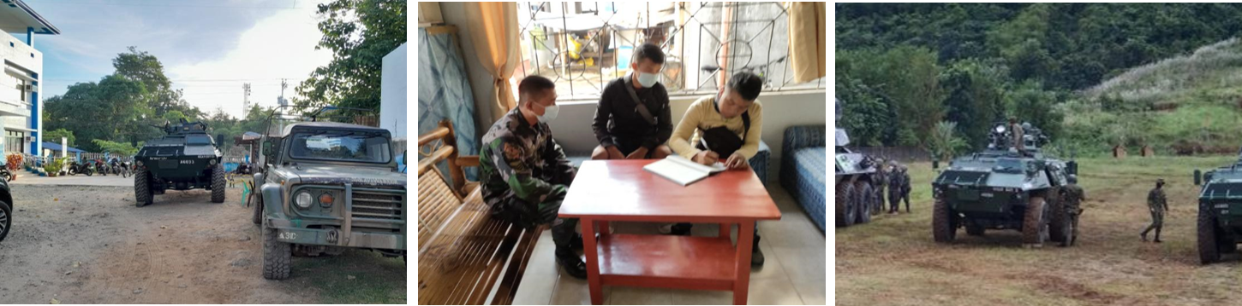
COMPLIANCE AND ACCOMPLISHMENTS TO CSAFP’s GUIDANCE
SECURITY AND STABILITY
“Intensify our support to the PNP and other law enforcement agencies in enforcing their anti-criminality, anti-drug and overall peace and order campaigns. Let us collaborate with the PNP on exchange of training and on sharing of best practices.”
The unit continuously engages and collaborates with other local security forces such as PNP to help in the overall peace and order campaigns in the local areas.
Notes:
Moving on to the compliances and accomplishments to Chief of Staff, AFP’s guidance the next six slides shows the unit’s modest efforts to fulfill the guidance and orders applicable to the company as one of the maneuver forces of Armor Division and 3ID, PA. On the aspect of security and stability, the unit continuously engages and collaborates with other local security forces such as PNP to help in the overall peace and order campaigns in the local areas. (Click)

Slide 93
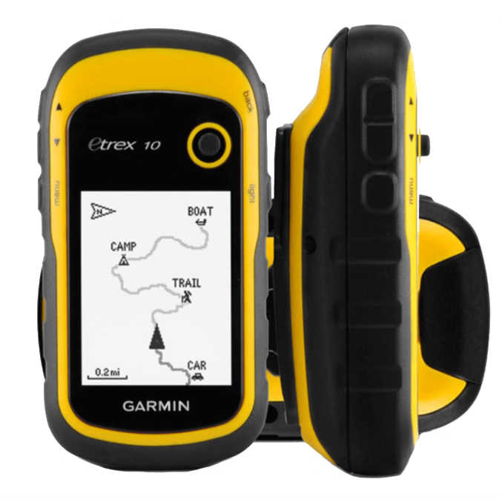
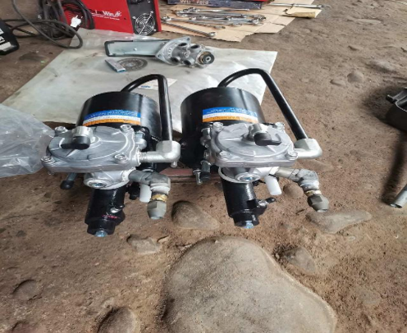
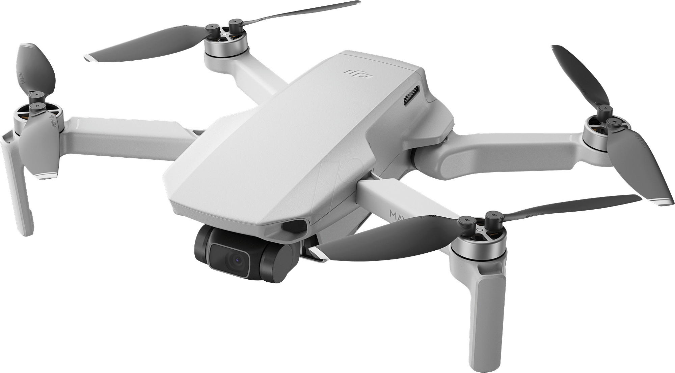
COMPLIANCE AND ACCOMPLISHMENTS TO CSAFP’s GUIDANCE
MATERIEL UPGRADE
“Prioritize the procurement of ‘game changer capabilities’…”
In the unit’s modest efforts in enhancing its capabilities and steadily increasing its equipment readiness, a number of the procured equipment can be considered as game-changer capabilities.
Notes:
On materiel upgrade focusing on the game-changer capabilities, the unit’s modest efforts in enhancing its capabilities and steadily increasing its equipment readiness, a number of the procured equipment can be considered as game-changer capabilities such as the upgrade brake module system, drone and additional GPS devices. (Click)

Slide 94
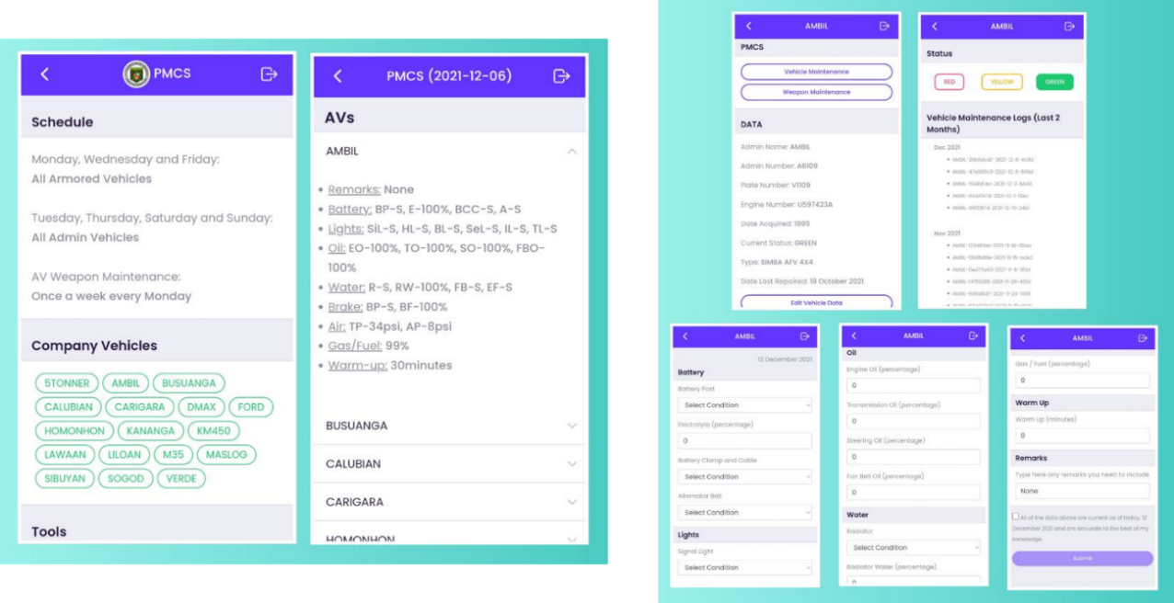
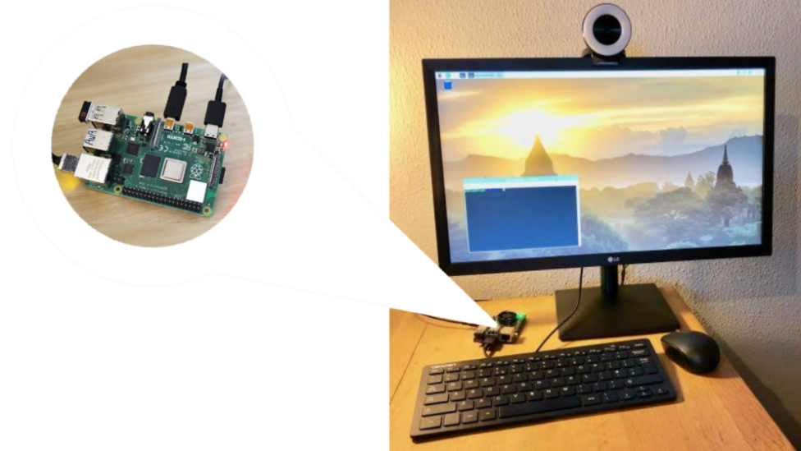
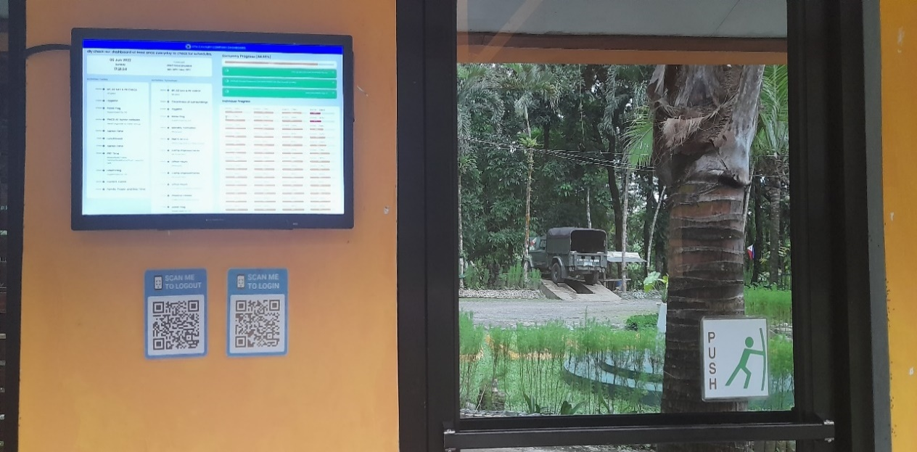
COMPLIANCE AND ACCOMPLISHMENTS TO CSAFP’s GUIDANCE
INTERNAL SYSTEMS AND PROCESSES
“Formulate appropriate measures, set targets, and launch initiatives to make "Ease of Doing Business" a part of our organizational transformation.”
The unit’s internal systems and processes such as PMCS, personnel administration and resource management have been enhanced and streamlined by capitalizing on available technologies.
Notes:
On the formulation of measures, targets and initiatives aimed at achieving the “Ease of Doing Business”, unit’s internal systems and processes such as PMCS, personnel administration and resource management have been enhanced and streamlined by capitalizing on available technologies. (Click)

Slide 95
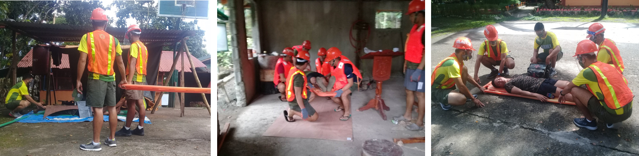
COMPLIANCE AND ACCOMPLISHMENTS TO CSAFP’s GUIDANCE
HUMANITARIAN ASSISTANCE AND DISASTER RESPONSE
“Continuously build capabilities to perform a wide array of missions especially in HADR, community support and development, and nation-building activities.”
Through trainings and seminars such as HADR, BMAT and TC3 and through equipment preparedness, the unit continuously enhances and builds its HADR capabilities.
Notes:
On building HADR capabilities, the unit continuously enhances and builds its HADR capabilities through trainings and seminars such as HADR, BMAT and TC3 and through equipment preparedness. (Click)

Slide 96
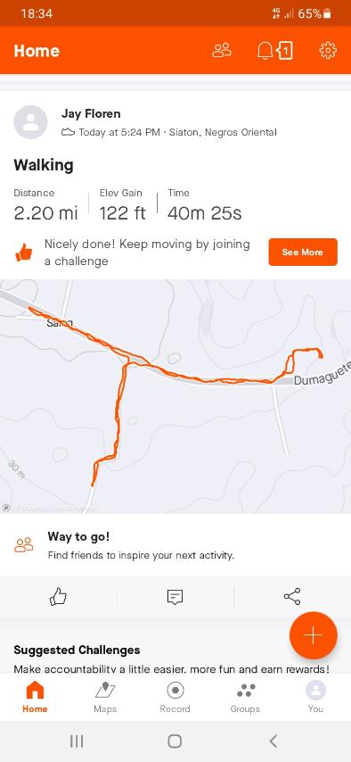
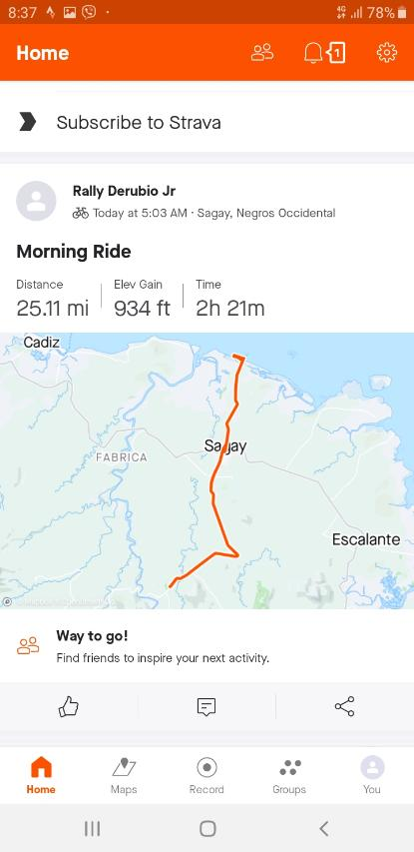
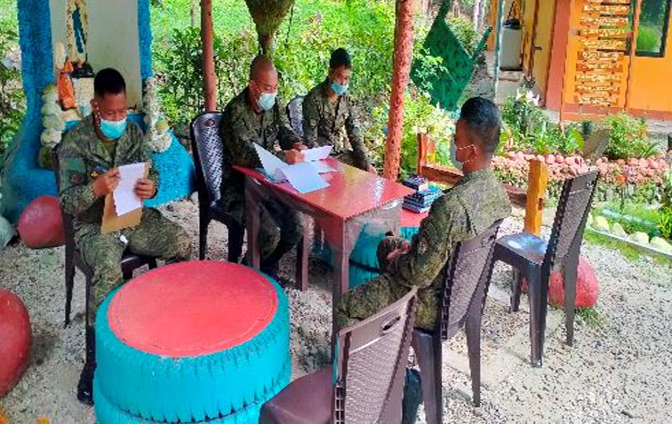
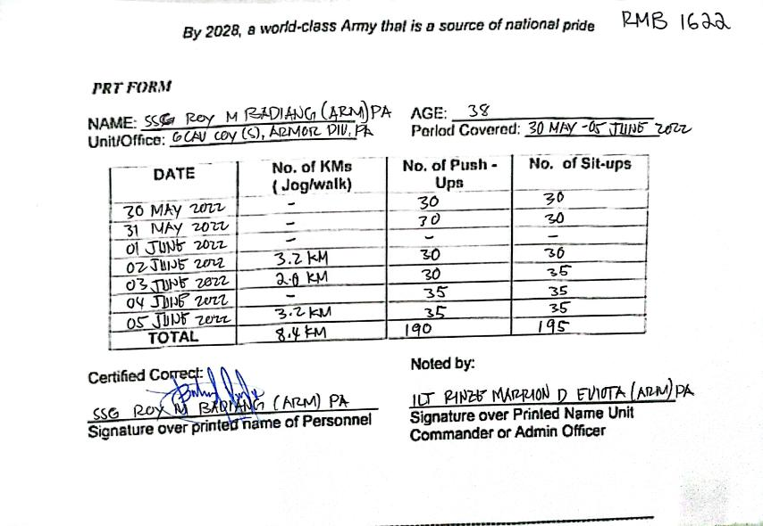
COMPLIANCE AND ACCOMPLISHMENTS TO CSAFP’s GUIDANCE
PERSONNEL DEVELOPMENT AND WELL-BEING
“Put premium on merit and fitness in hiring or promoting personnel and afford them continuous professional development for efficiency and for their morale…”
Unit’s leadership regularly conducts developmental counseling to all personnel to ensure they are all in the right paths of their military careers. On fitness, it is a company policy to submit weekly PRT Forms with attached screenshot of Roadrun tracking apps.
Notes:
On personnel development and well-being, unit’s leadership regularly conducts developmental counseling to all personnel to ensure they are all in the right paths of their military careers. On fitness, it is a company policy to submit weekly PRT Forms with attached screenshot of Roadrun tracking apps. (Click)

Slide 97
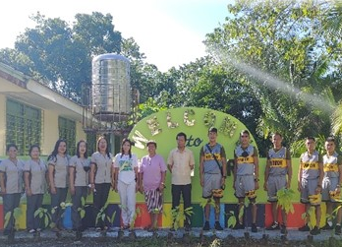
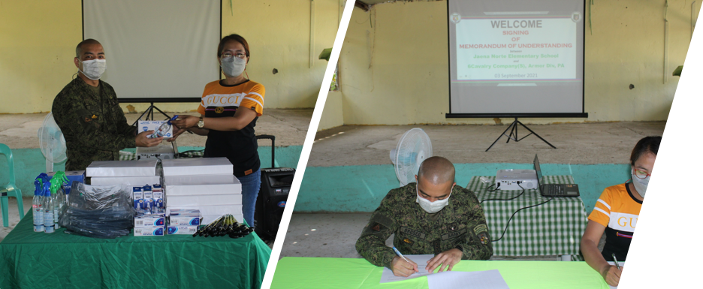
COMPLIANCE AND ACCOMPLISHMENTS TO CSAFP’s GUIDANCE
STAKEHOLDERS’ COLLABORATION
“Continue to engage with and strengthen partnerships with all relevant stakeholders to sustain the peace, ensure security, and help maintain public order.”
The unit maintains its efforts in intensifying its stakeholders’ engagements and socio-civic activities in order to help sustain the peace, ensure security and maintain public order.
Notes:
To continue engage with and strengthen partnerships with all relevant stakeholders, the unit maintains its efforts in intensifying its stakeholders’ engagements and socio-civic activities through the unit’s Stakeholder Engagement Program in order to help sustain the peace, ensure security and maintain public order. (Click)

Slide 98
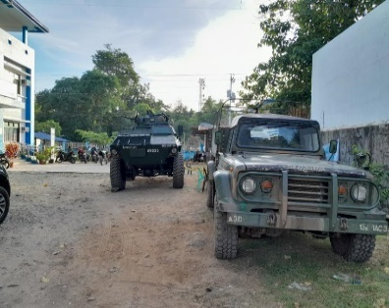
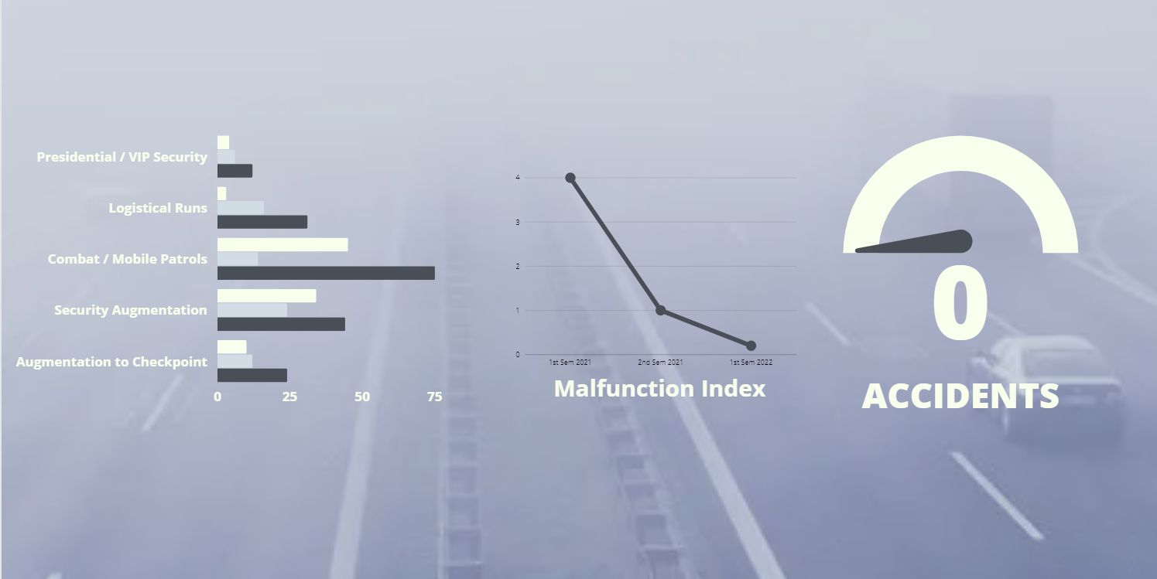
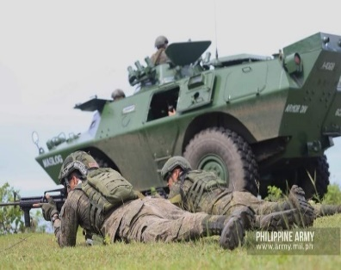
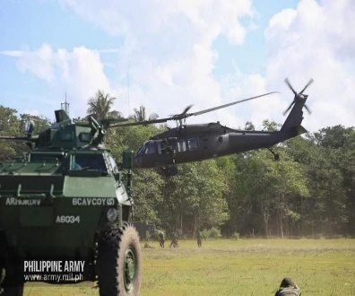
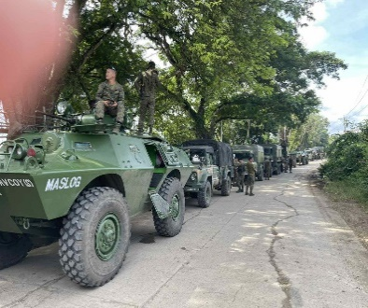
UNIT SIGNIFICANT ACCOMPLISHMENTS
OPERATIONS
CAPABILITY
ADMINISTRATION
Significant increase in the number of major tactical operations while maintaining the unit’s zero-accident and low malfunction index record.
Notes:
The next 3 slides will be on the unit’s modest accomplishments, firstly on operations. There has been a significant increase in the number of major tactical operations while maintaining the unit’s zero-accident and low malfunction index record from 1st sem 2021, 2nd sem 2021 and 1st sem 2022. (Click)

Slide 99
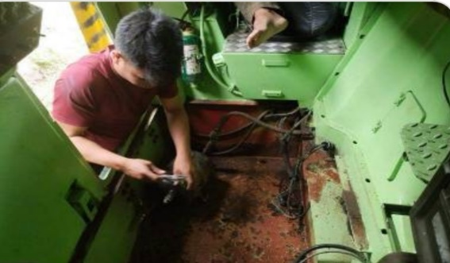
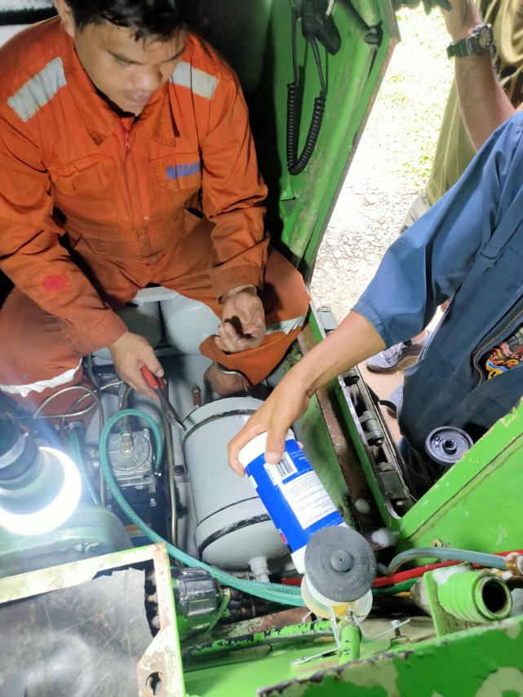
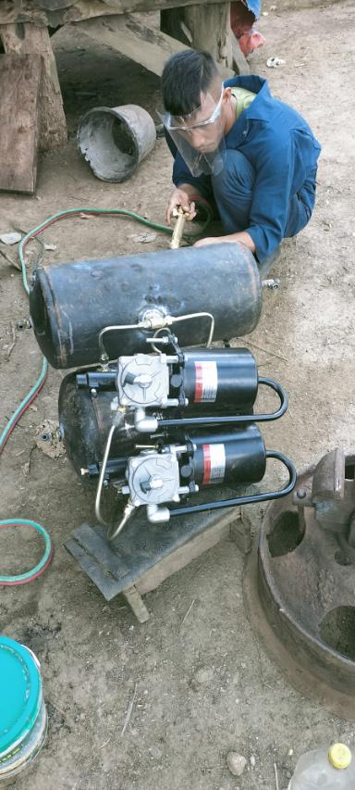
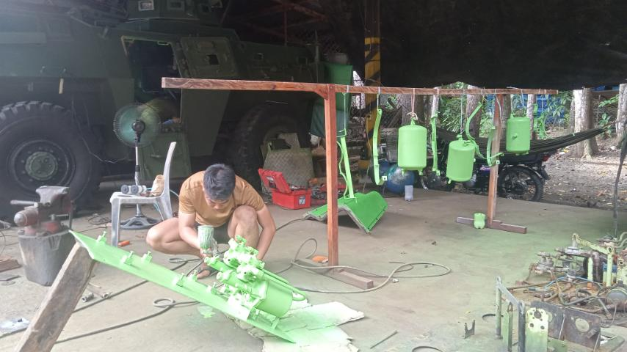
UNIT SIGNIFICANT ACCOMPLISHMENTS
OPERATIONS
CAPABILITY
ADMINISTRATION
CAPABILITY
ADMINISTRATION
Successfully completed the brake module system upgrades of all twelve (12) armored vehicles of the unit.
Notes:
On the capability, last May 2022 the unit has finally completed the 100% installation of the upgraded brake module systems of all 12 AVs of the unit which boosted the confidence of AV crews in driving their respective armored vehicles. (Click)

Slide 100

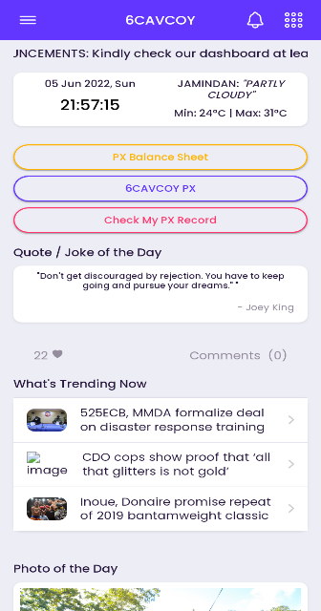
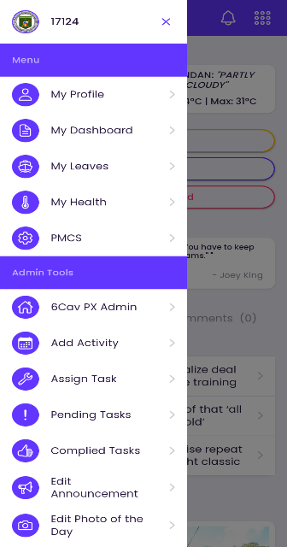
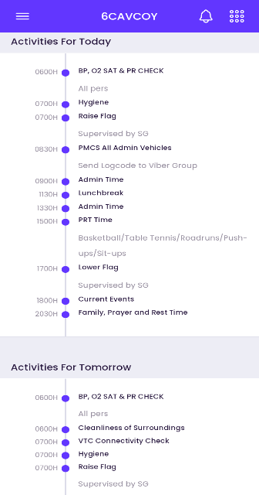
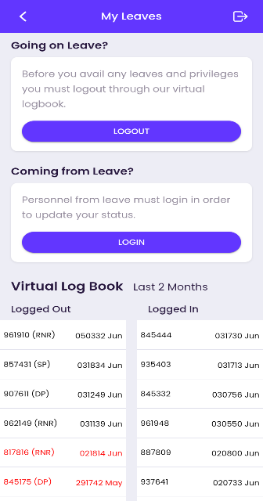
UNIT SIGNIFICANT ACCOMPLISHMENTS
ADMINISTRATION
OPERATIONS
CAPABILITY
ADMINISTRATION
ADMINISTRATION
Company information system, PMCS Web App and Scanner Logbook greatly enhanced administration and streamlined the unit’s traditional systems and processes.
Notes:
And lastly on administration the company information system, PMCS Web App and Scanner Logbook greatly enhanced administration and streamlined the unit’s traditional systems and processes. (Click)

Slide 101
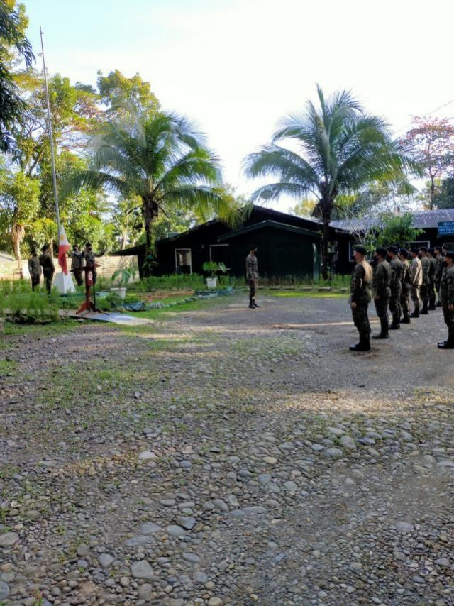
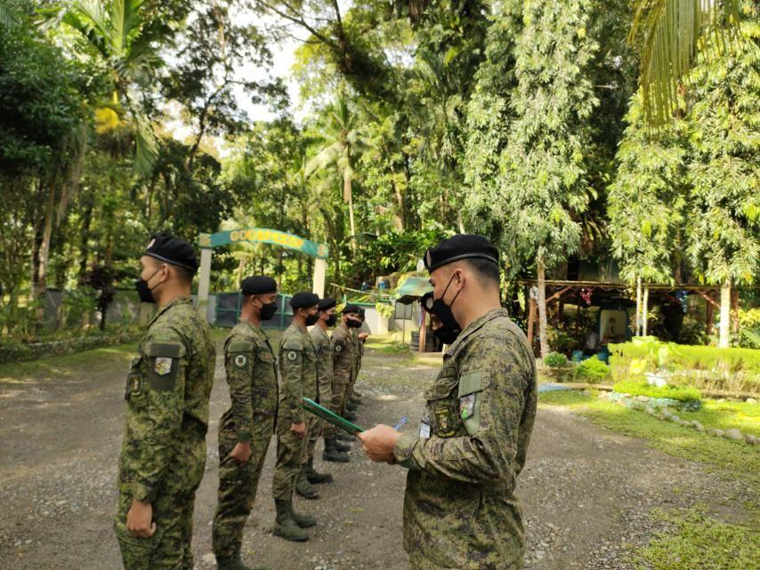


UNIT SIGNIFICANT ACCOMPLISHMENTS
Character and Competency Development
Monday Flag Raising
Rank Inspection
NCO Council
Sunday Mass
Notes:
And lastly on administration the company information system, PMCS Web App and Scanner Logbook greatly enhanced administration and streamlined the unit’s traditional systems and processes. (Click)

Slide 102



UNIT SIGNIFICANT ACCOMPLISHMENTS
Character and Competency Development
Lecture on Harris 7800H Digital Intercom
Online Quiz after the Lecture on Harris 7800 intercom
Lecture on Financial Literacy
Notes:
And lastly on administration the company information system, PMCS Web App and Scanner Logbook greatly enhanced administration and streamlined the unit’s traditional systems and processes. (Click)

Slide 103



UNIT SIGNIFICANT ACCOMPLISHMENTS
Procurement of Drone
Notes:
And lastly on administration the company information system, PMCS Web App and Scanner Logbook greatly enhanced administration and streamlined the unit’s traditional systems and processes. (Click)

Slide 104




UNIT SIGNIFICANT ACCOMPLISHMENTS
Random Drug test
Notes:
And lastly on administration the company information system, PMCS Web App and Scanner Logbook greatly enhanced administration and streamlined the unit’s traditional systems and processes. (Click)

Slide 105






UNIT SIGNIFICANT ACCOMPLISHMENTS
Inventory of Firearms and Ammunition

Slide 106






UNIT SIGNIFICANT ACCOMPLISHMENTS
AJEX “DAGIT-PA” 06-2022

Slide 107



UNIT SIGNIFICANT ACCOMPLISHMENTS
Repainting of 12 AVs + 1 AMC

Slide 108
ISSUES AND CONCERNS
ISSUES AND CONCERNS | FUNCTIONAL STAFF
ACCOMODATION OF PERSONNEL PROGRAMMED FOR CAREER COURSES
OG1
Notes:
For the last part of my presentation, the unit’s issues and concerns are the following, ring gears for the turret systems of 2 CMDO V-150 of the unit. Likewise, on C4S additional five (5) VHF 5-50W Vehicular Radios to increase the unit’s C4S equipment readiness while on C4S maintenance the repair or replacement of 2 manpack radios and 5 handheld radios will significantly increase the unit’s C4S maintenance readiness. (END)

